Slide 1
Machine Learning Basics

Slide 2
What is Machine Learning?
A machine learning algorithm is an algorithm that is able to learn from seen data (training data), and predict on new, previously unseen data (test data).
Machine learning allows us to tackle tasks that are too difficult to solve with fixed programs (rules) written and designed by human beings.
Using data for answering questions
Training
Predicting

Slide 3
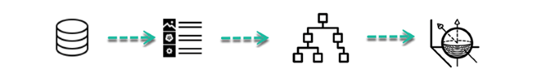
How does Machine Learning Work?
Learning Phase
Training data
Feature vector
Algorithm
Model

Slide 4
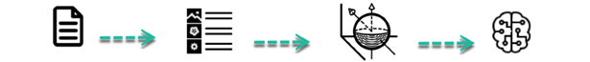
How does Machine Learning Work?
Learning Phase
Training data
Feature vector
Algorithm
Model
Inference Phase
Test data
Feature vector
Model
Prediction

Slide 5
Building a machine learning algorithm
A dataset
A model
A loss function
An optimization procedure

Slide 6
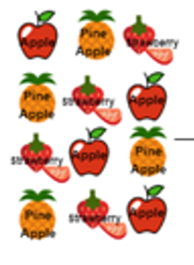
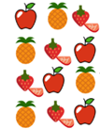
Category by training data
Machine Learning
Supervised
Unsupervised
Semi-supervised
Data with label
Data without label
Label + unlabeled data

Slide 7
Category by training data
Supervised learning : data with label
﻿Learn through examples of which we know the desired output (what we want to predict).

Slide 8
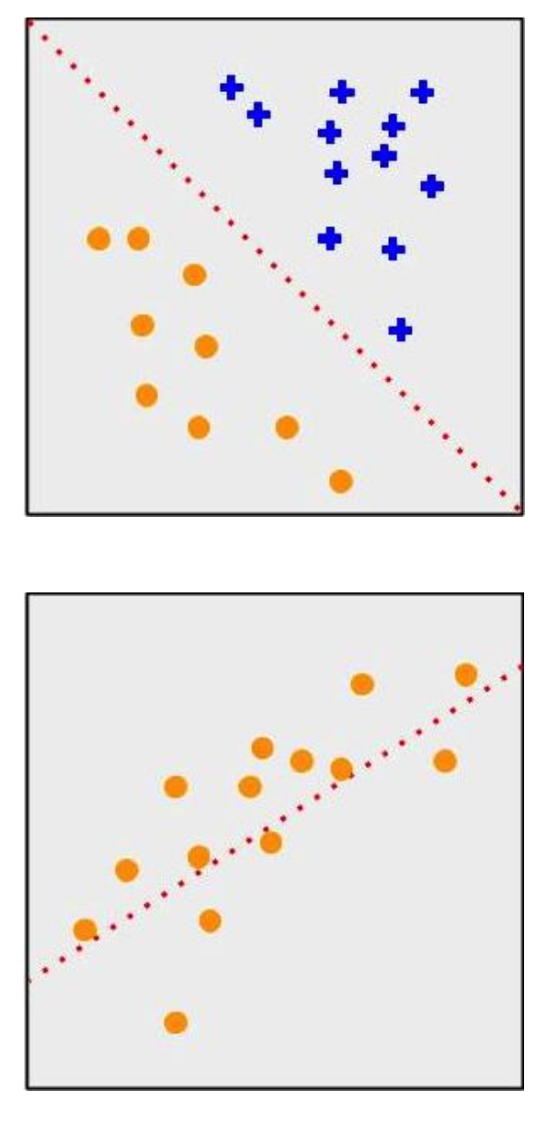
Category by training data
Supervised learning
Classification
﻿Output is a discrete variable (e.g., cat/dog)
Regression
﻿Output is continuous (e.g., price, temperature)

Slide 9
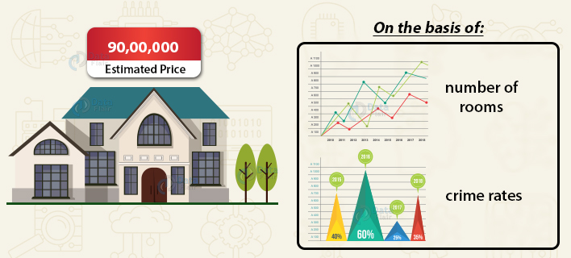
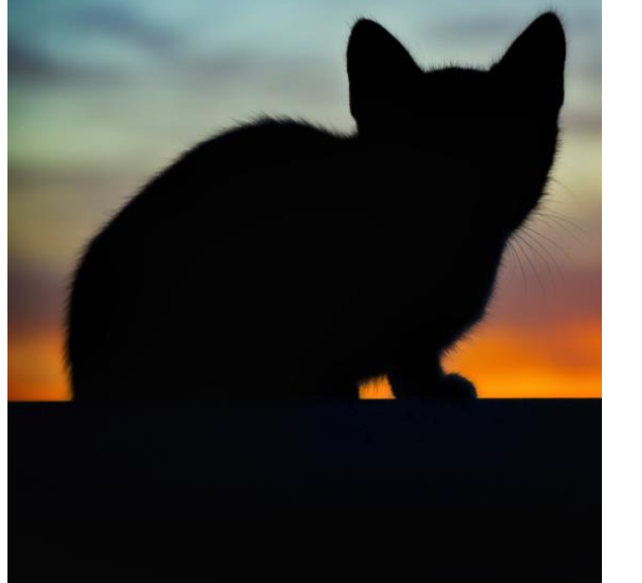
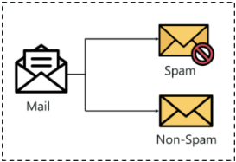
Category by training data
Applications of Supervised learning
﻿Is this a cat or a dog?
Are these emails spam or not?
Predict the market value of houses, given the square meters, number of rooms, neighborhood, etc.
Notes:
应用

Slide 10
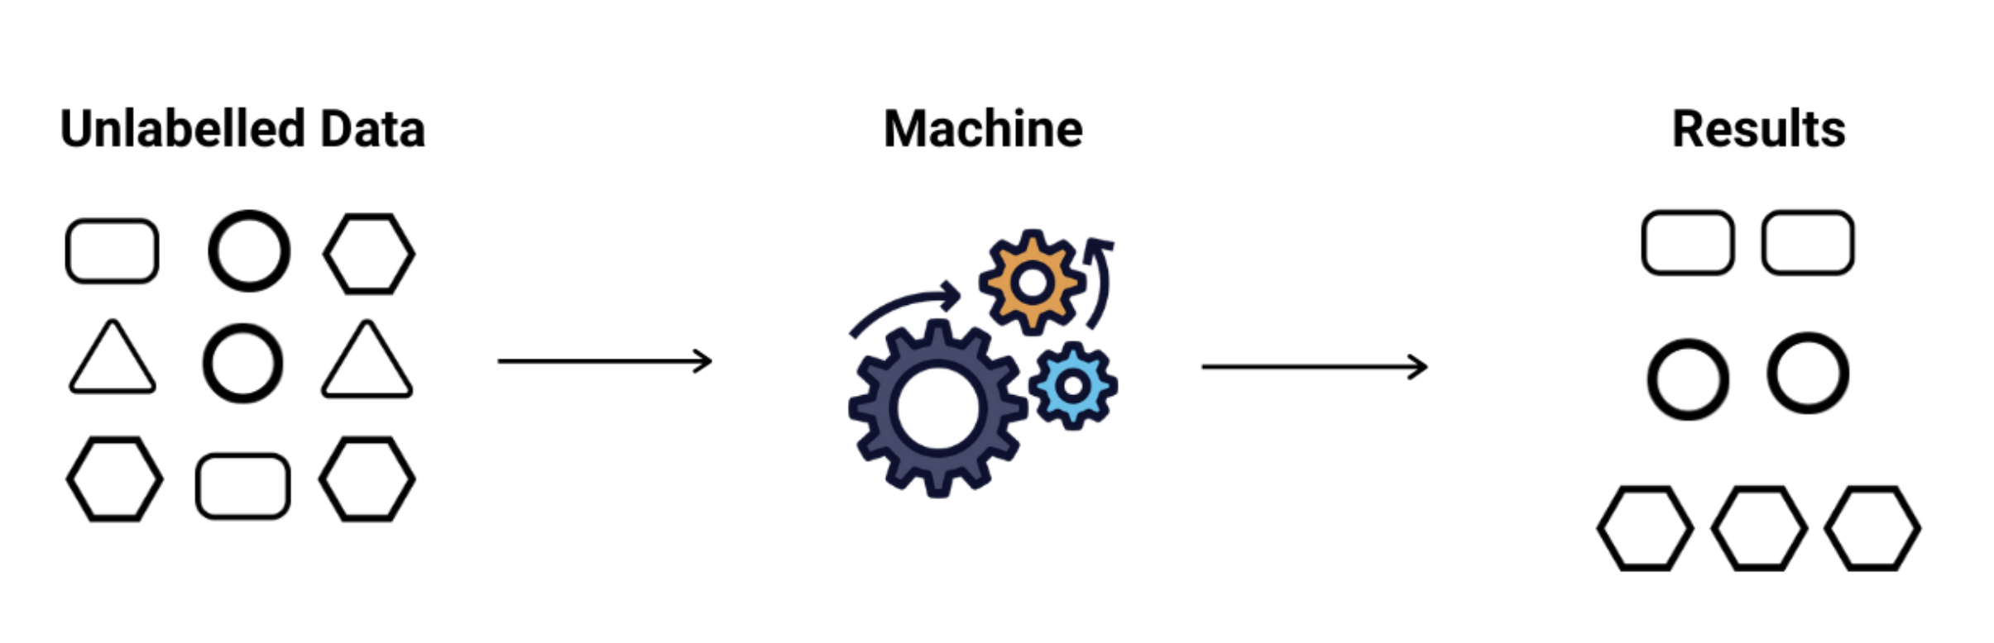
Category by training data
Unsupervised learning: data without label
﻿There is no desired output. Learn something about the data. Latent relationships.

Slide 11
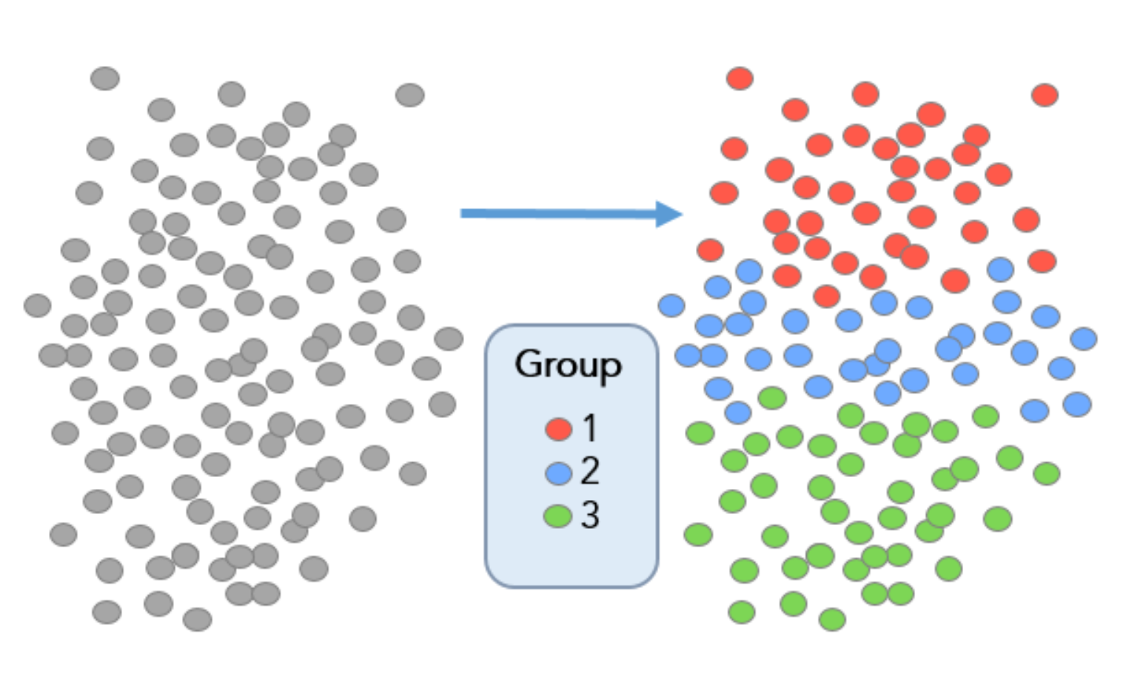
Category by training data
Unsupervised learning
Clustering
grouping the given data into different clusters or groups

Slide 12
Category by training data
Applications of Unsupervised learning
﻿I have photos and want to put them in 20 groups.
I want to find anomalies in the credit card usage patterns of my customers.

Slide 13
Category by training data
Semi-supervised learning: a mix of labeled and unlabeled data

Slide 14
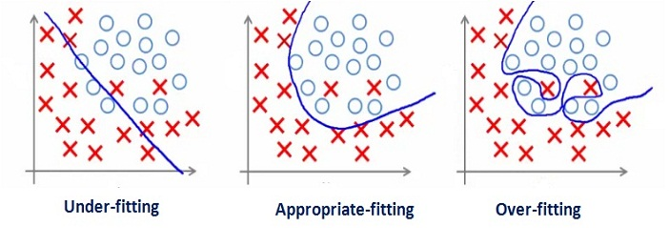
Underfitting and Overfitting
The objectives of an ML algorithm
Make the training error small. If fails → underfitting (欠拟合)
Make the gap between training and test error small. If fails → overfitting (过拟合)

Slide 15
Capacity
Definition: the ability to fit a wide variety of functions
One way to control the capacity of a learning algorithm is by choosing its hypothesis space, the set of functions that the learning algorithm is allowed to select as being the solution.
Example: a linear regression model
has a lower capacity than a quadratic one

Slide 16
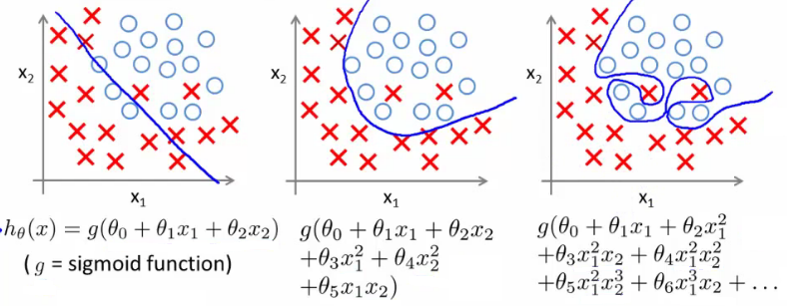
Capacity
Underfitting
Low capacity
High bias
Overfitting
High capacity
High variance

Slide 17
Capacity vs. Error

Slide 18
Hyperparameter and Validation Sets
Hyperparameters are settings that we can use to control the behavior of the learning algorithm. The values of hyperparameters are not adapted by the learning algorithm itself.
We do not learn the hyperparameter because it is not appropriate to learn that hyperparameter on the training set (e.g., all hyperparameters that control model capacity).
We split the training data into two disjoint subsets. One of these subsets is used to learn the parameters. The other subset is our validation set, used to estimate the generalization error during or after training, allowing for the hyperparameters to be updated accordingly.

Slide 19
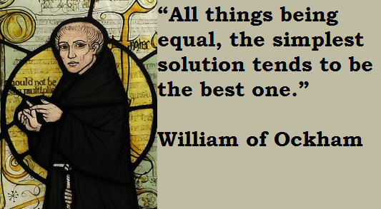
Regularization in a narrow sense
Motivation:
Occam’s Razor

Slide 20
Regularization in a broad sense
Regularization is any modification we make to a learning algorithm that is intended to reduce its generalization error but not its training error.
Regularization controls a model’s capacity by expressing preferences for different solutions, both implicitly and explicitly
Neural networks are usually regularized implicitly in many ways (e.g. dropout, data augmentation, early stopping)

Slide 21
Image Classification

Slide 22
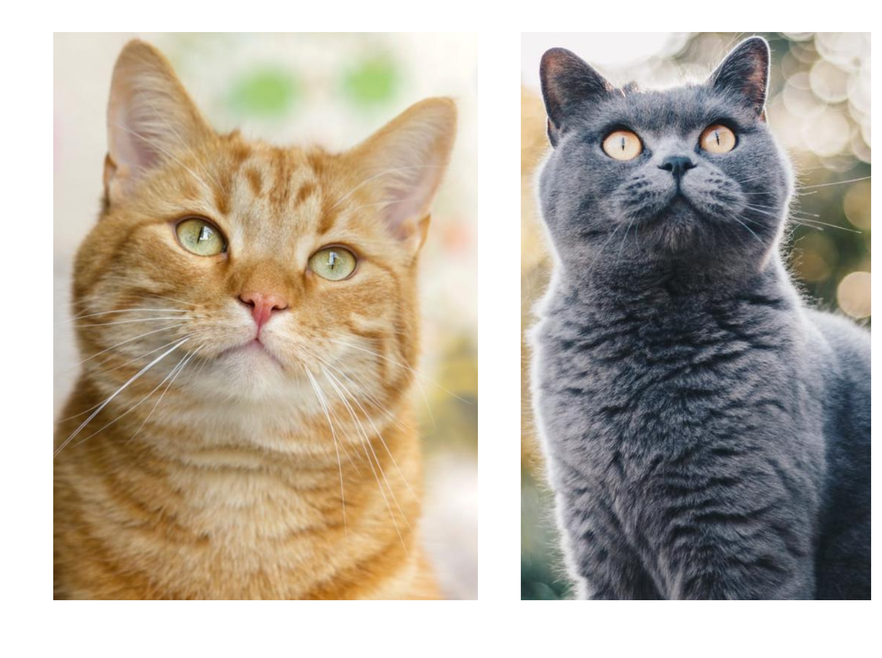
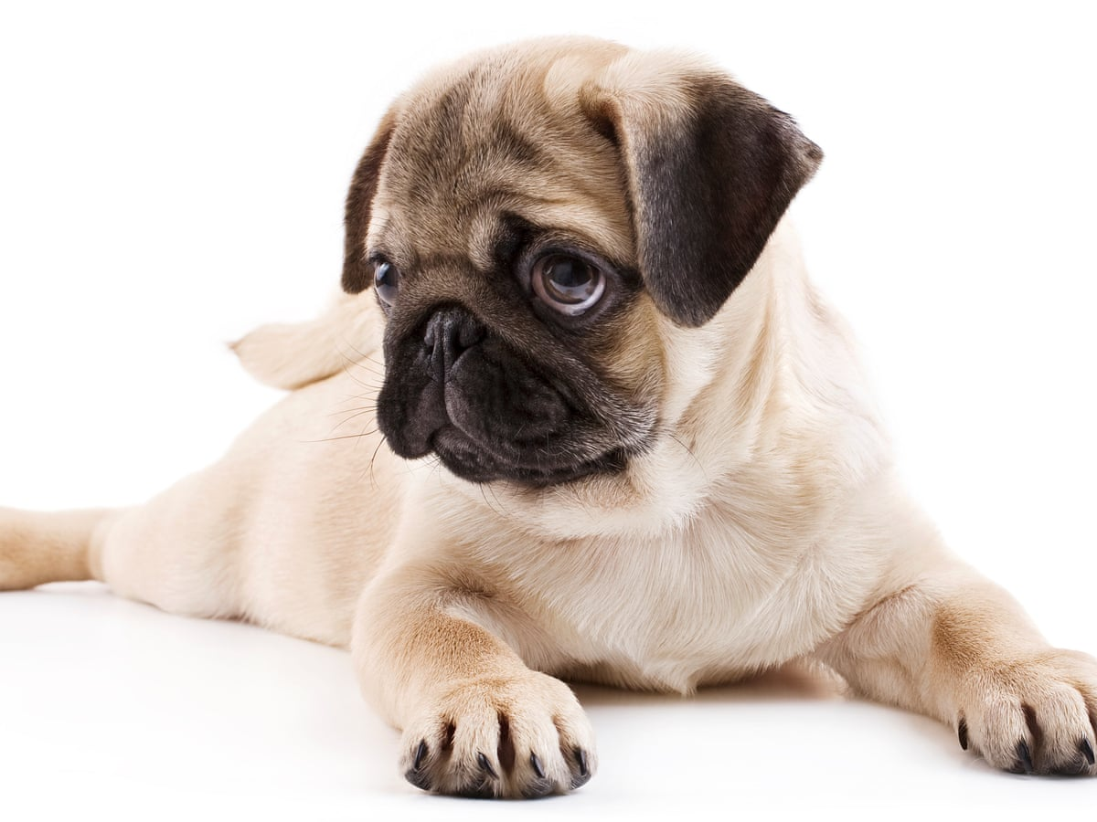
Image Classification
dog
cat

Slide 23
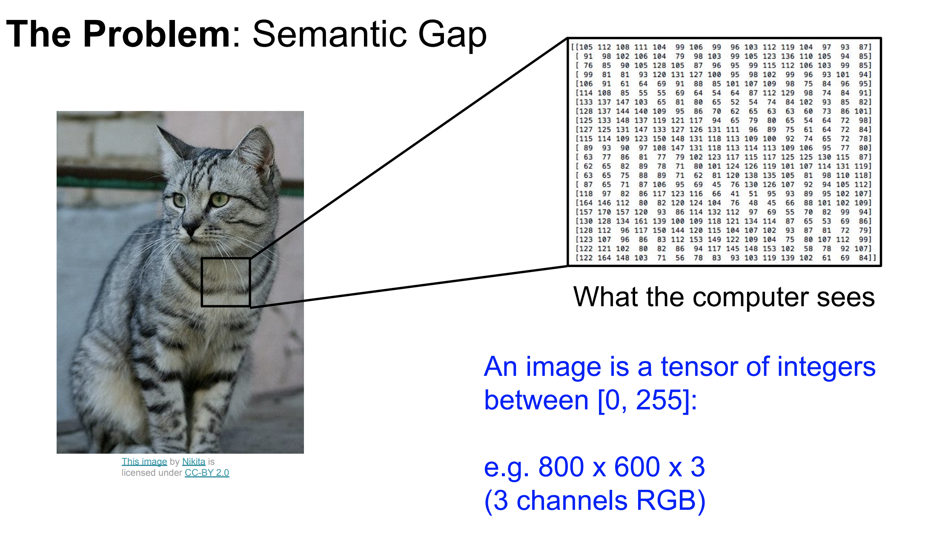
Image Classification

Slide 24
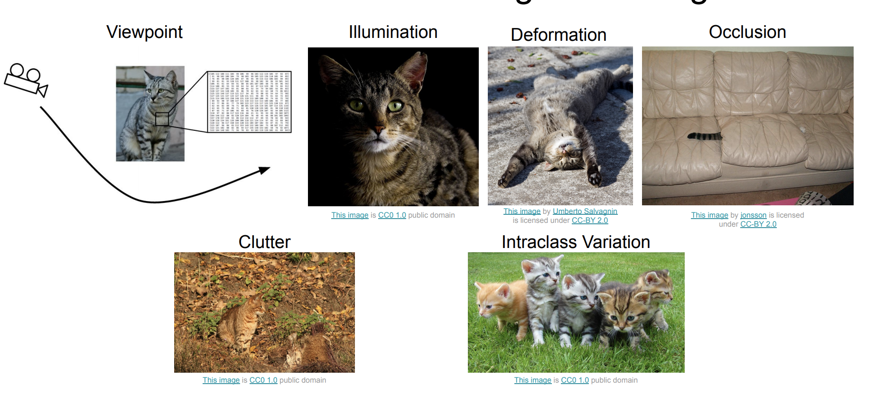
Challenges

Slide 25
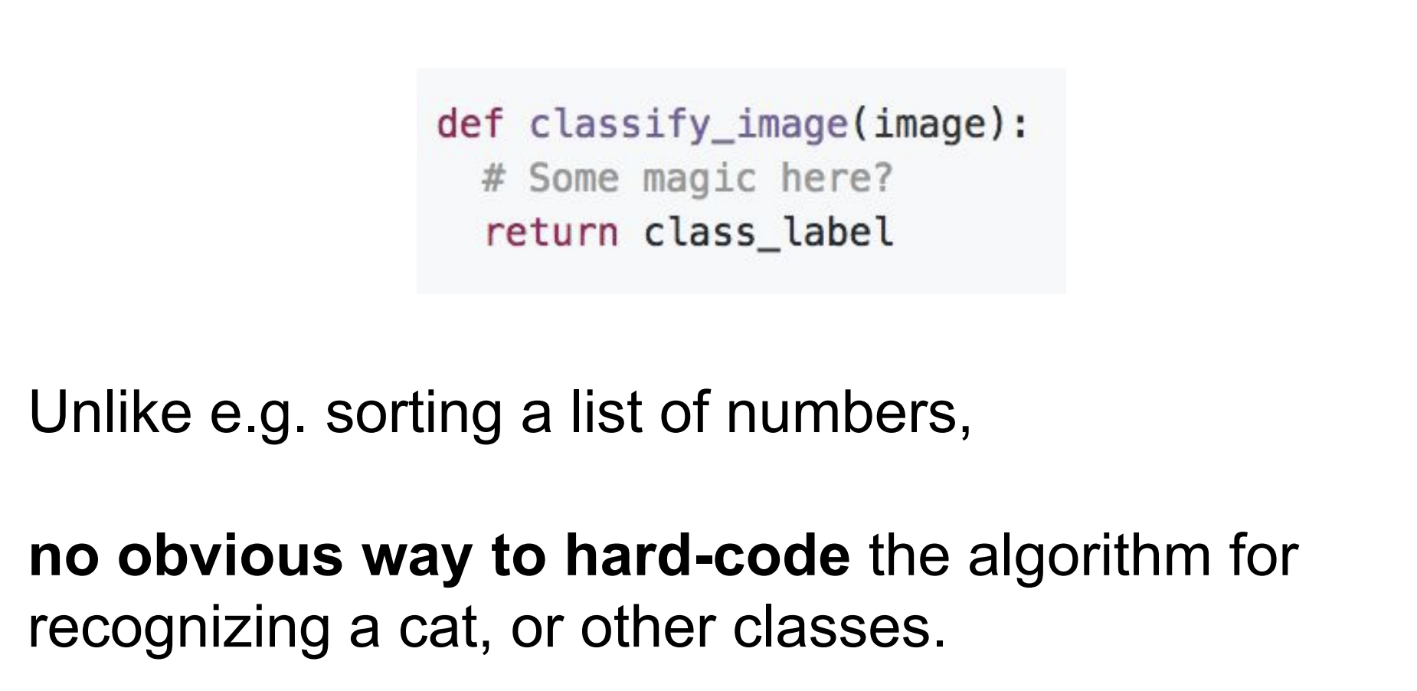
Image Classifier

Slide 26
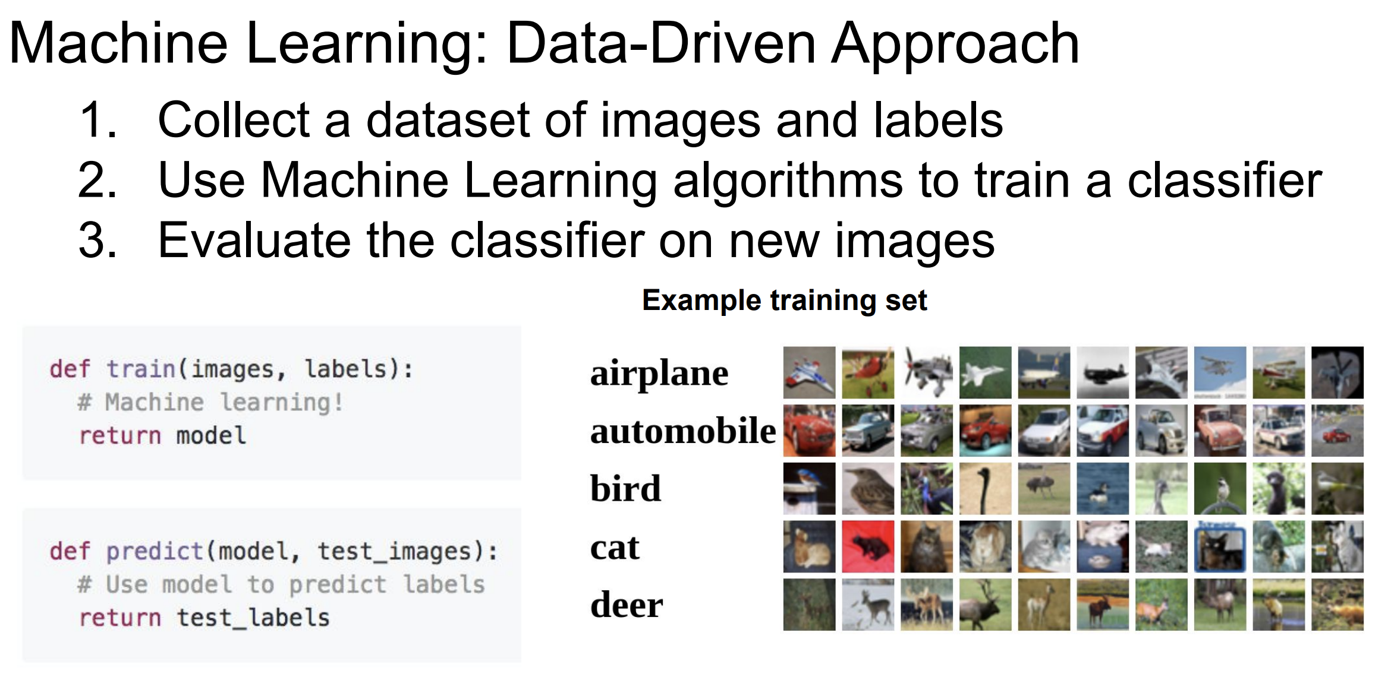
Approach

Slide 27
Nearest Neighbor Classifier

Slide 28
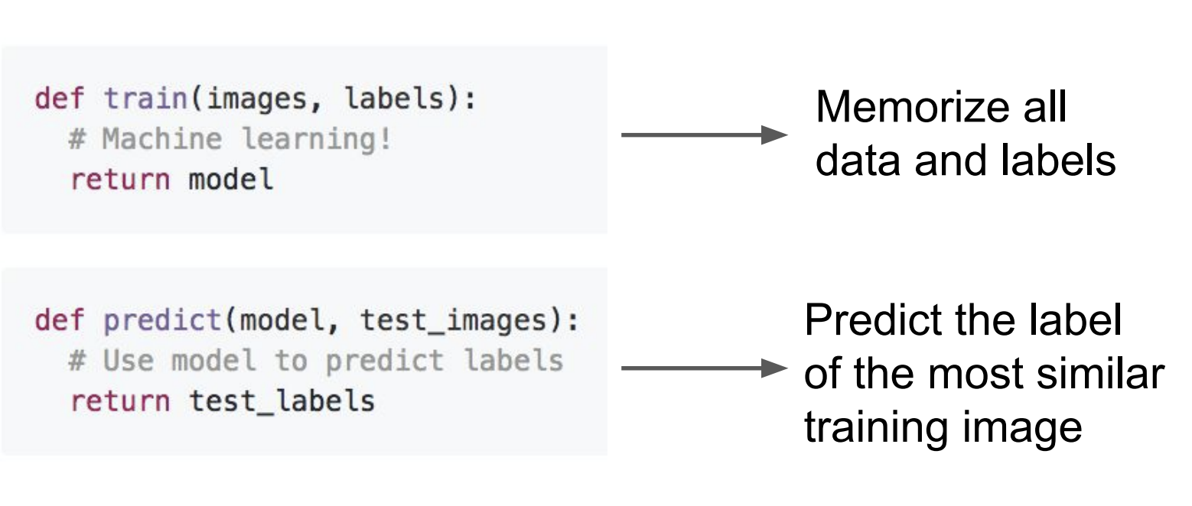
Classifier: Nearest Neighbor

Slide 29
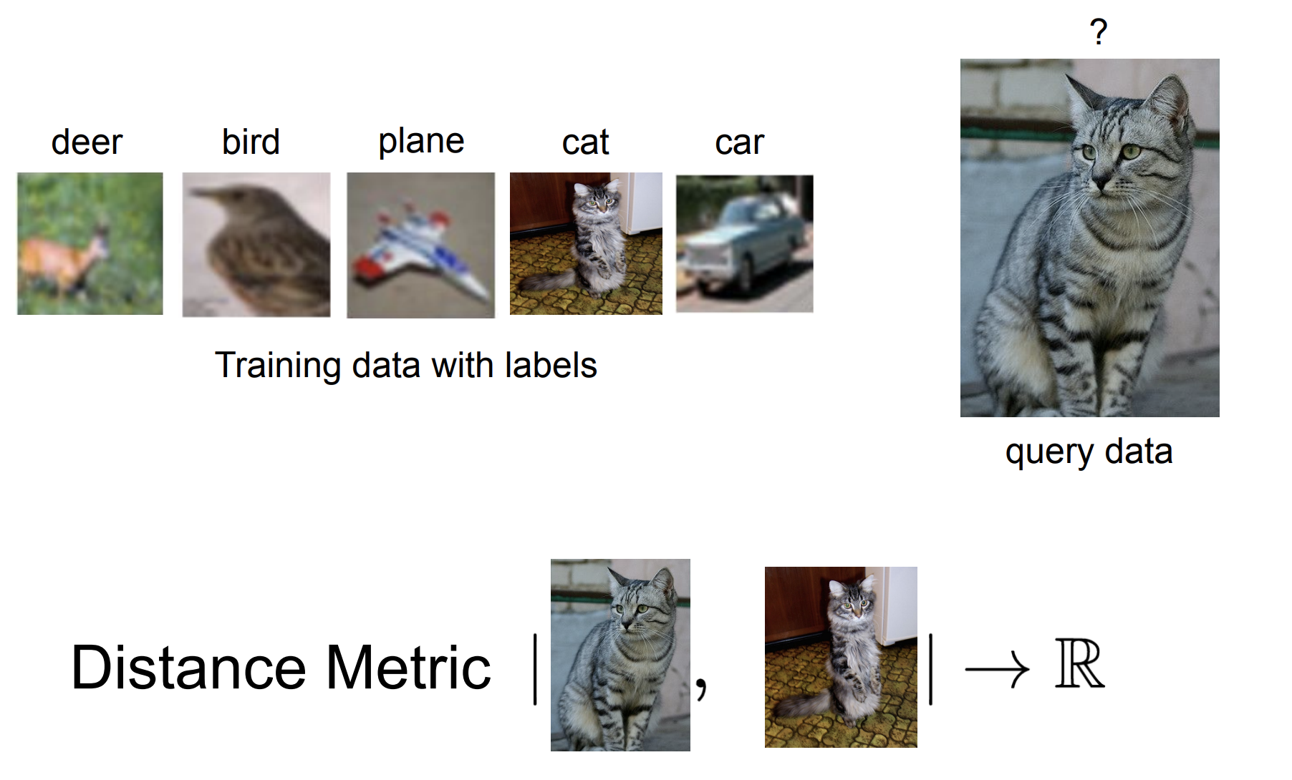
Classifier: Nearest Neighbor

Slide 30
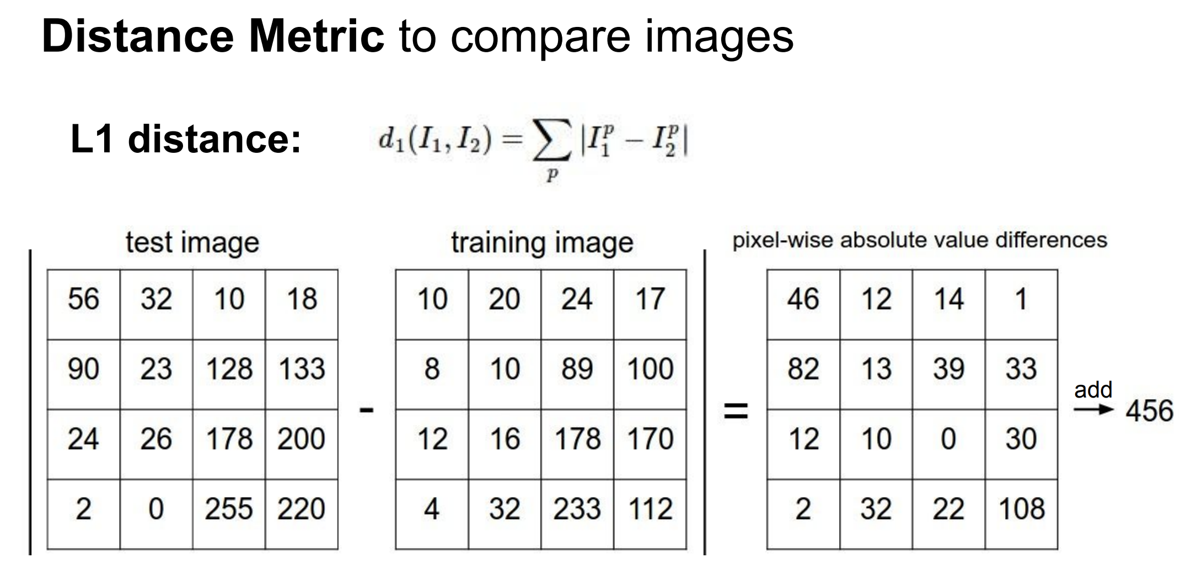
Classifier: Nearest Neighbor

Slide 31
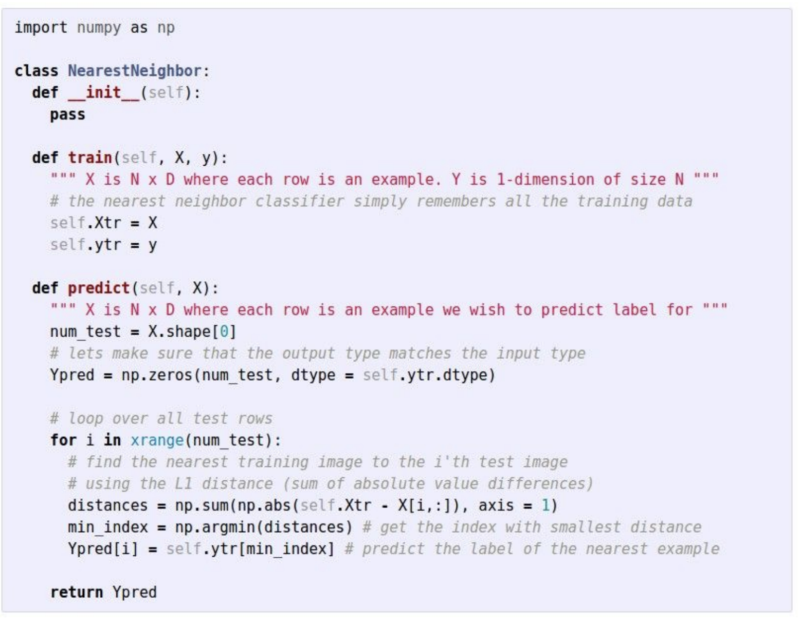

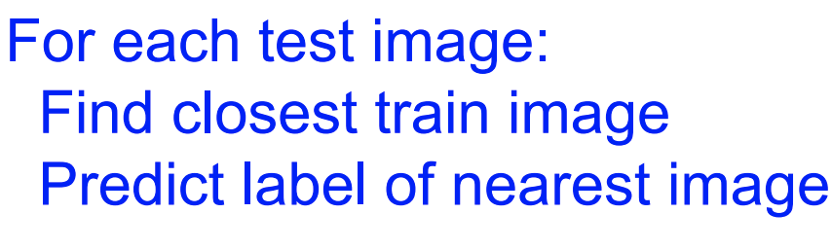
Classifier: Nearest Neighbor

Slide 32
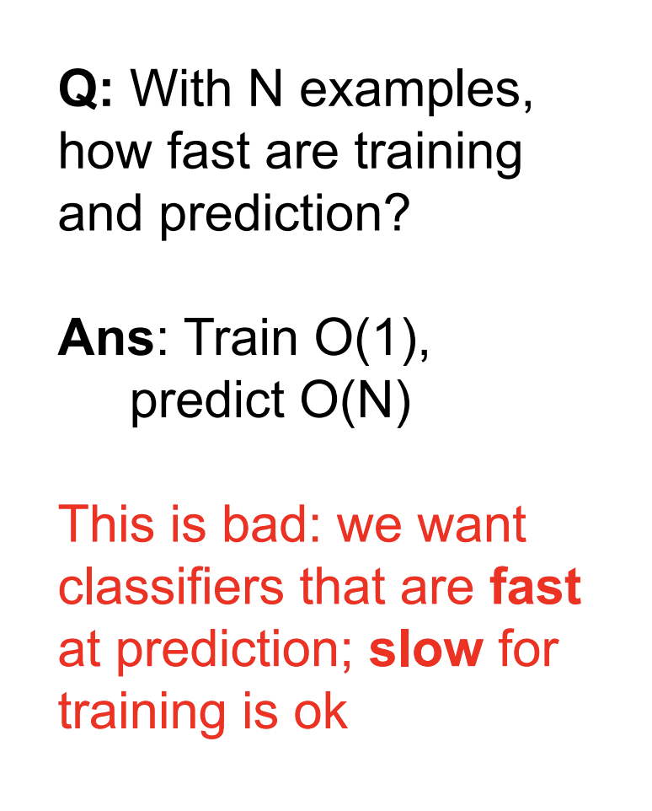
Classifier: Nearest Neighbor

Slide 33
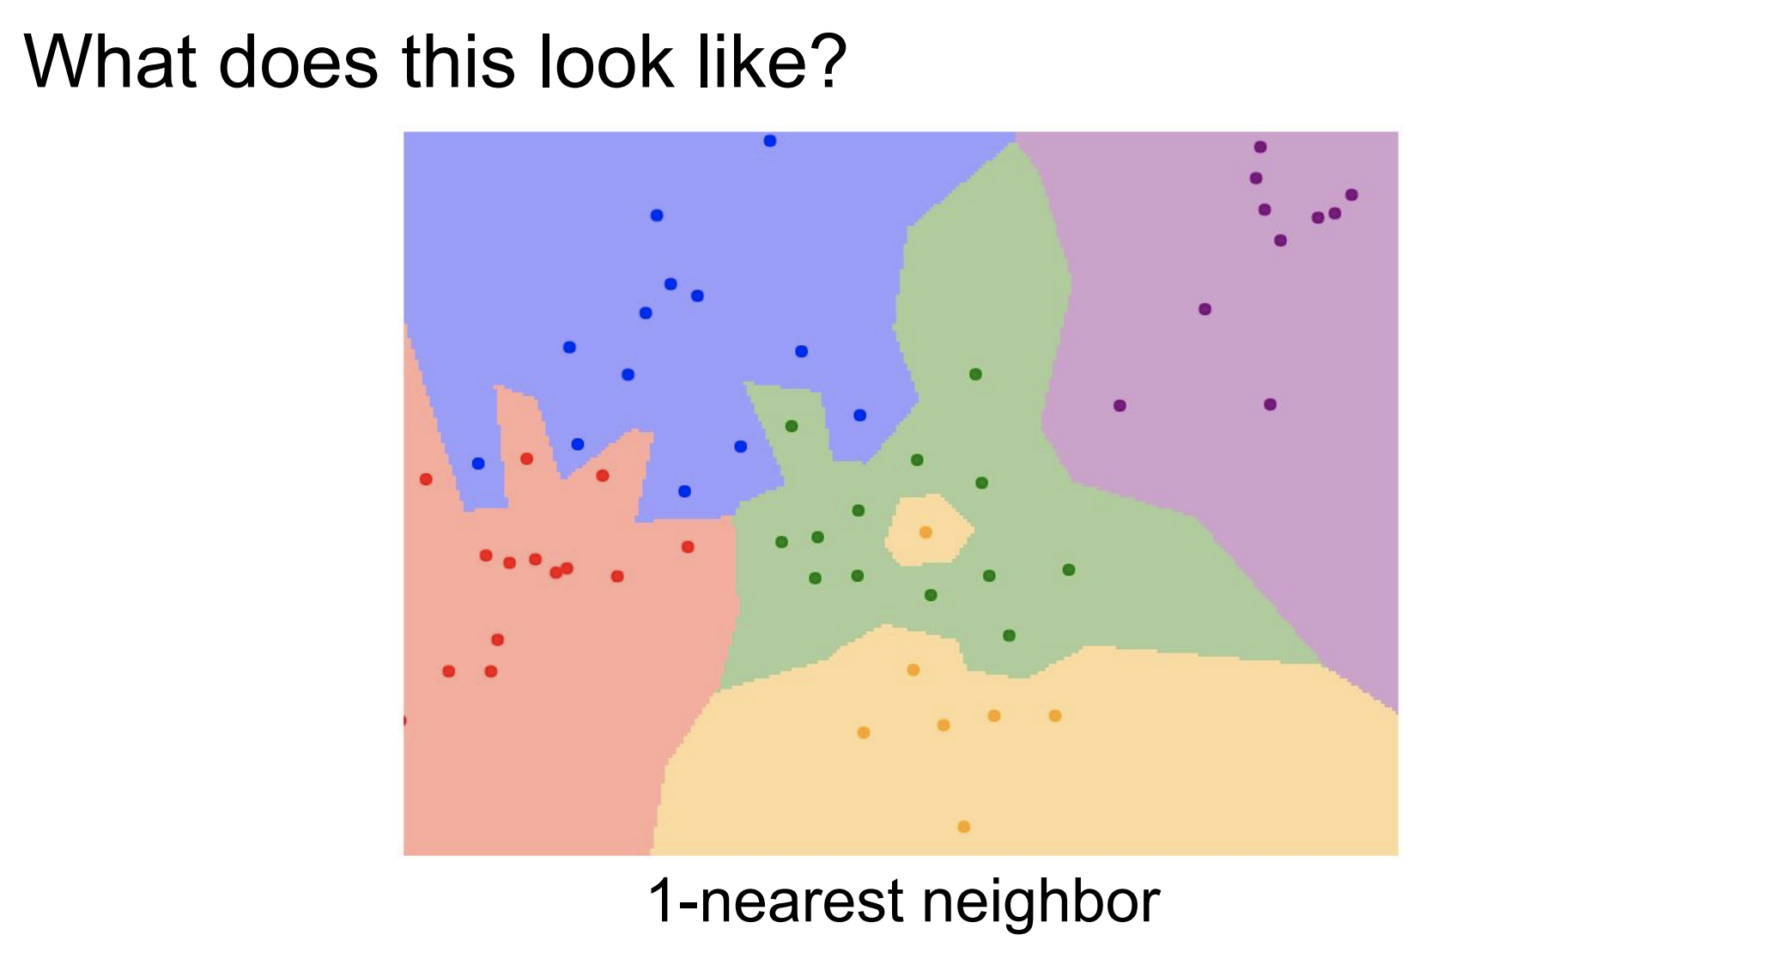
Classifier: Nearest Neighbor

Slide 34
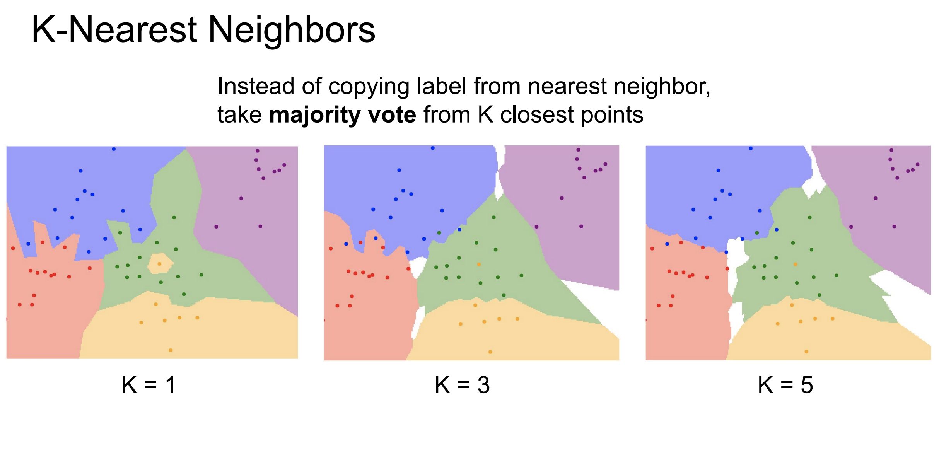
Classifier: K-Nearest Neighbor

Slide 35
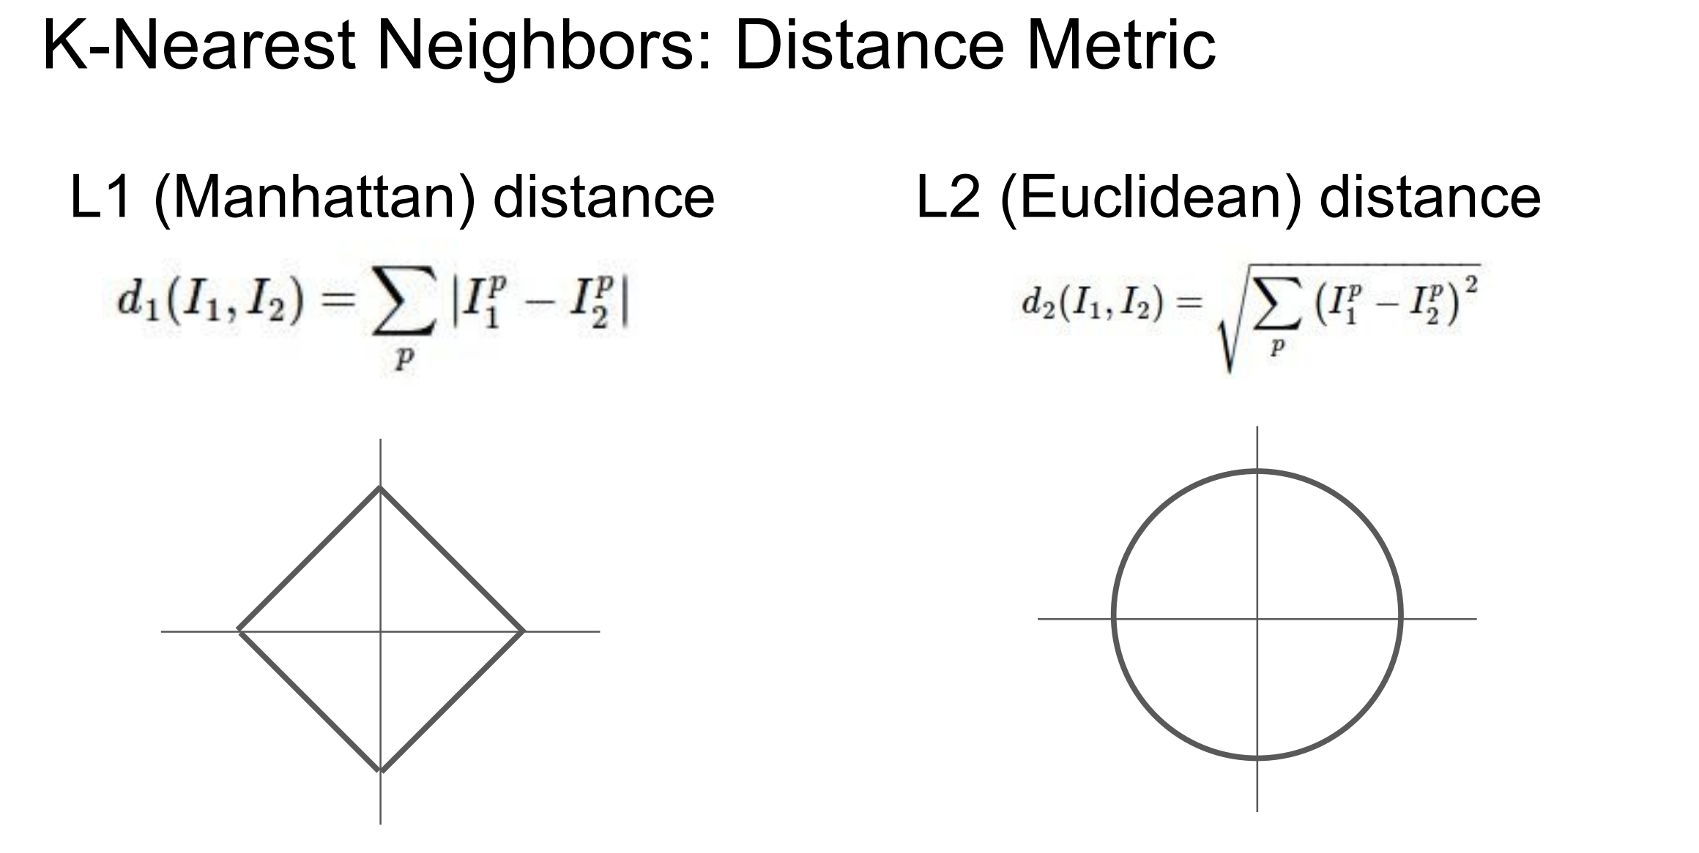
Classifier: K-Nearest Neighbor

Slide 36
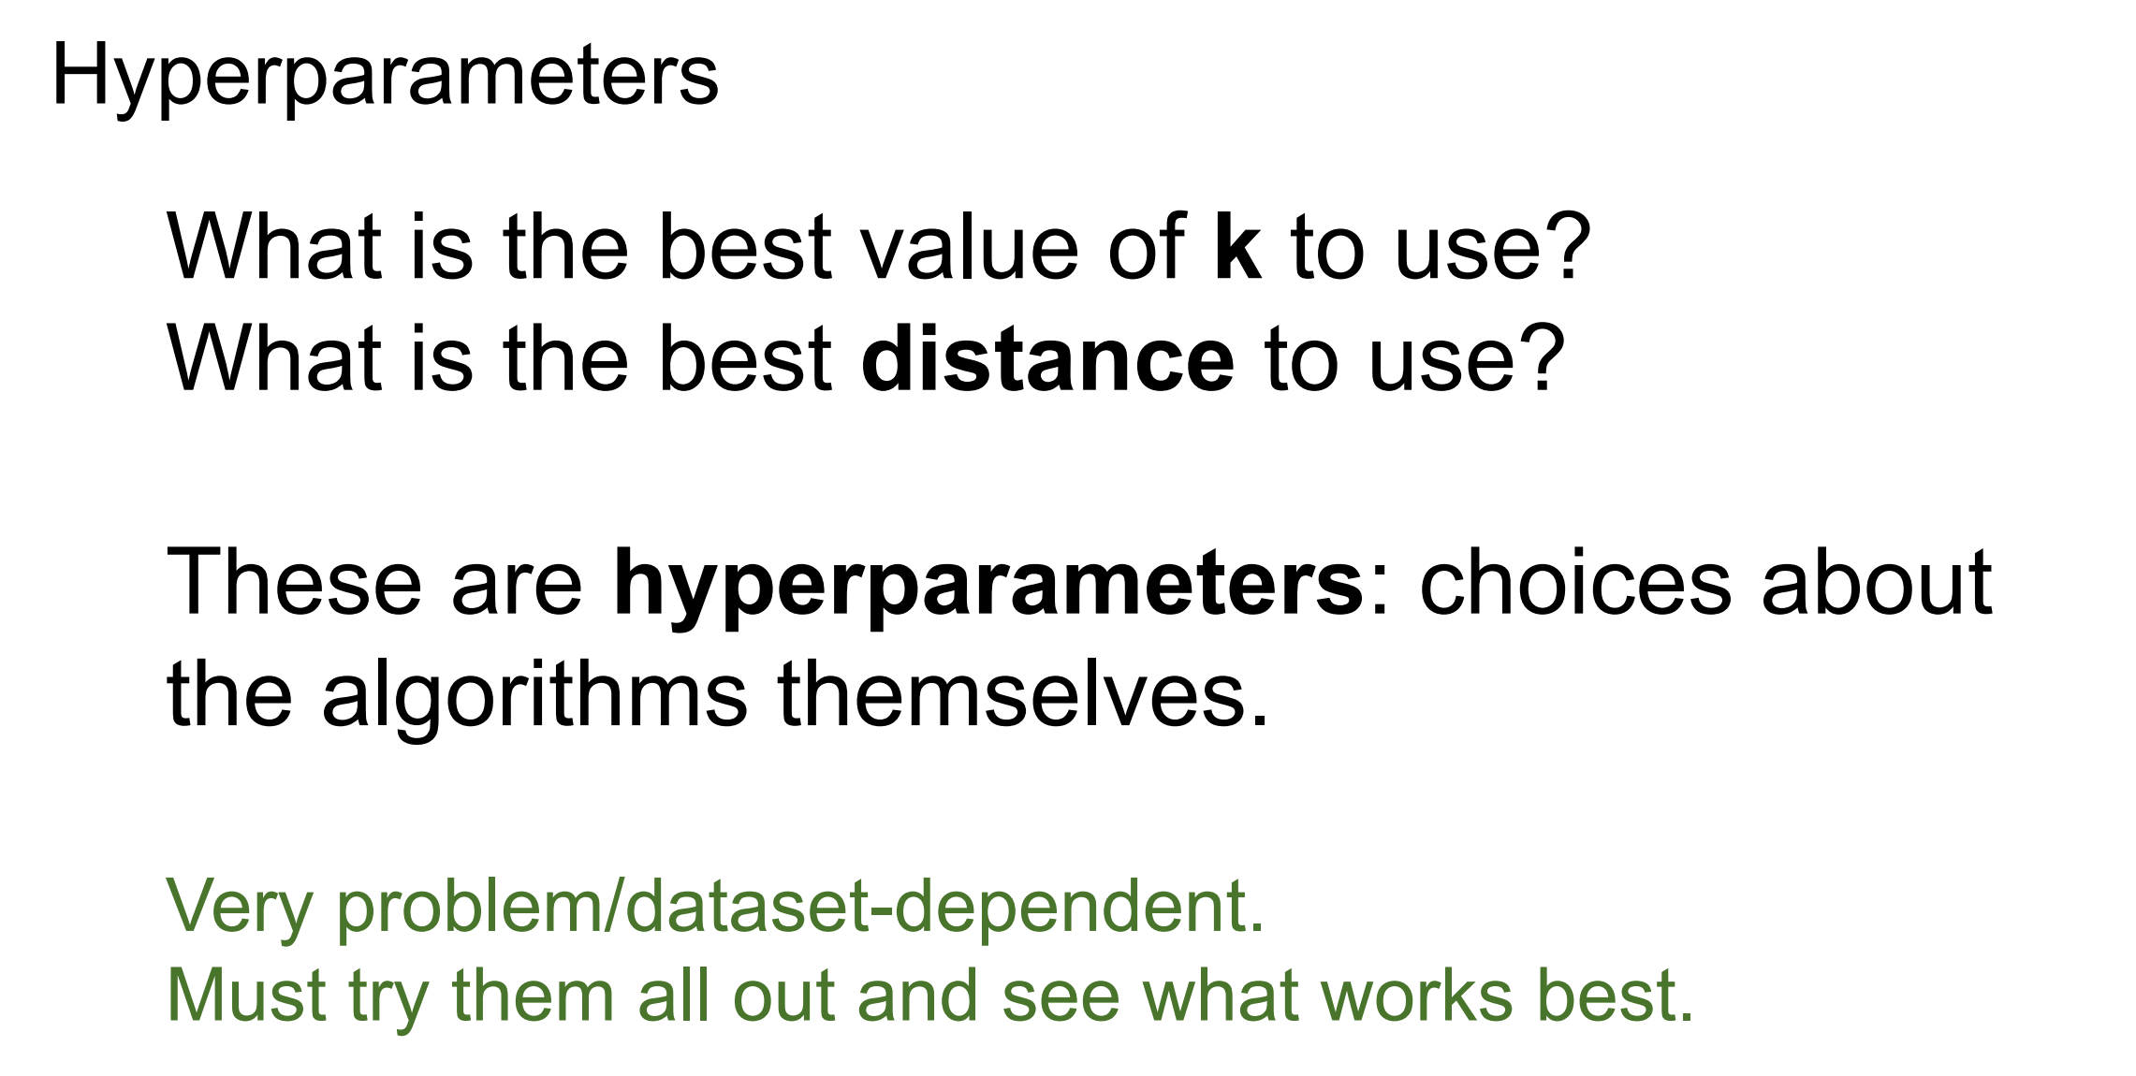
Classifier: Nearest Neighbor

Slide 37
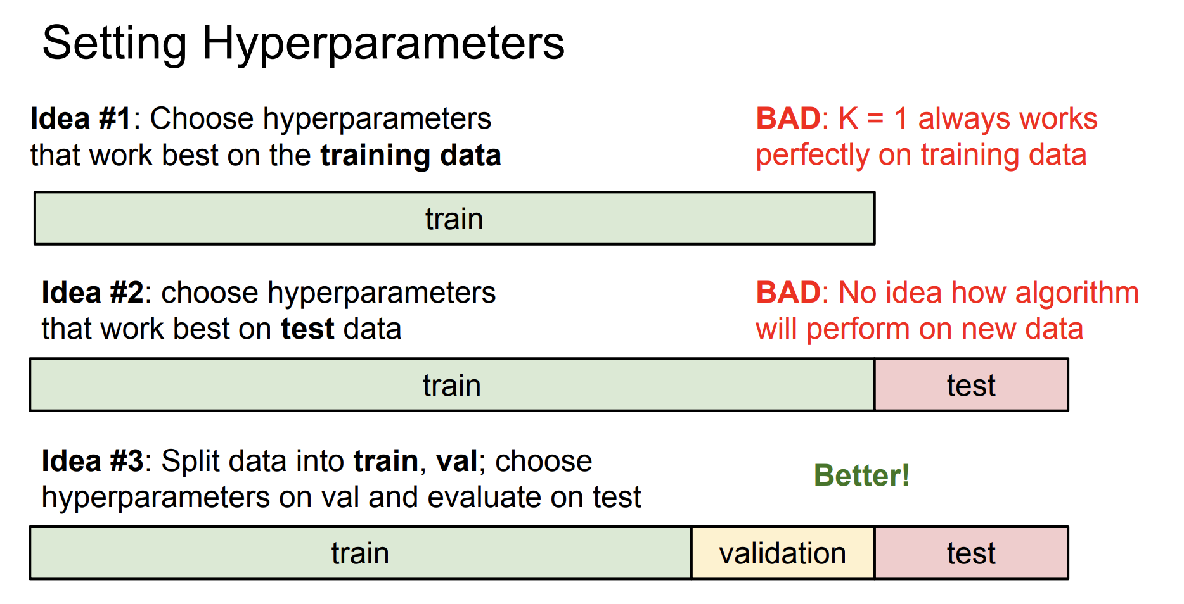
Classifier: K-Nearest Neighbor

Slide 38

Classifier: K-Nearest Neighbor

Slide 39
Classifier: K-Nearest Neighbor

Slide 40
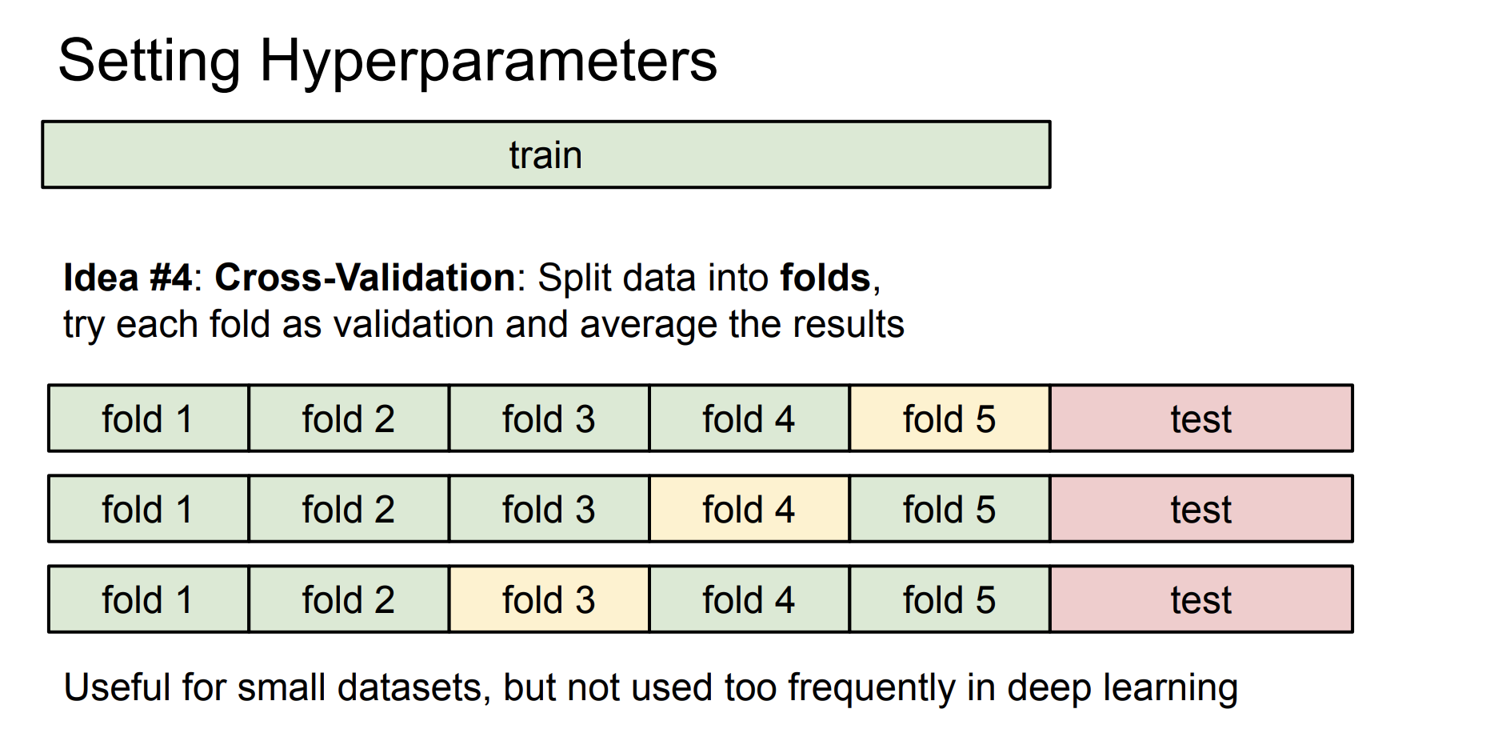
Classifier: K-Nearest Neighbor

Slide 41
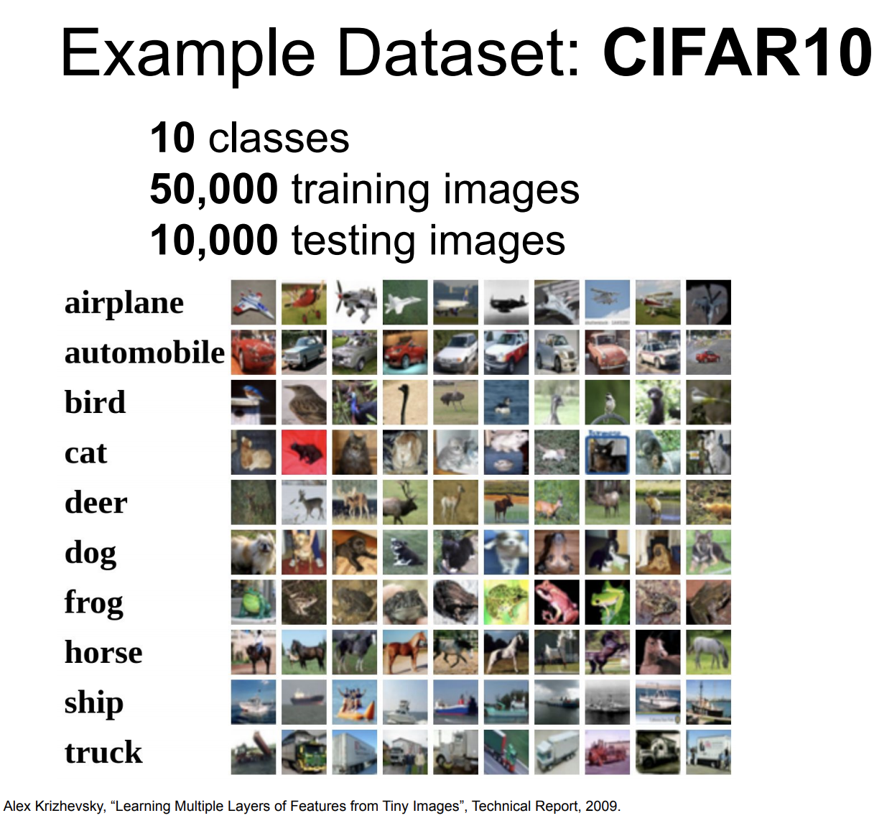
Classifier: K-Nearest Neighbor

Slide 42
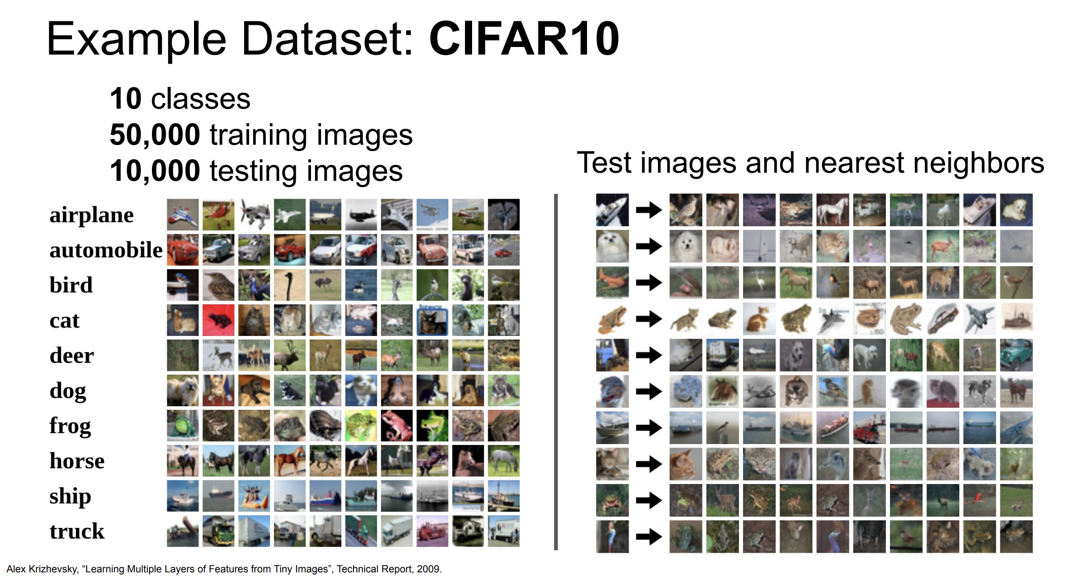
Classifier: K-Nearest Neighbor

Slide 43
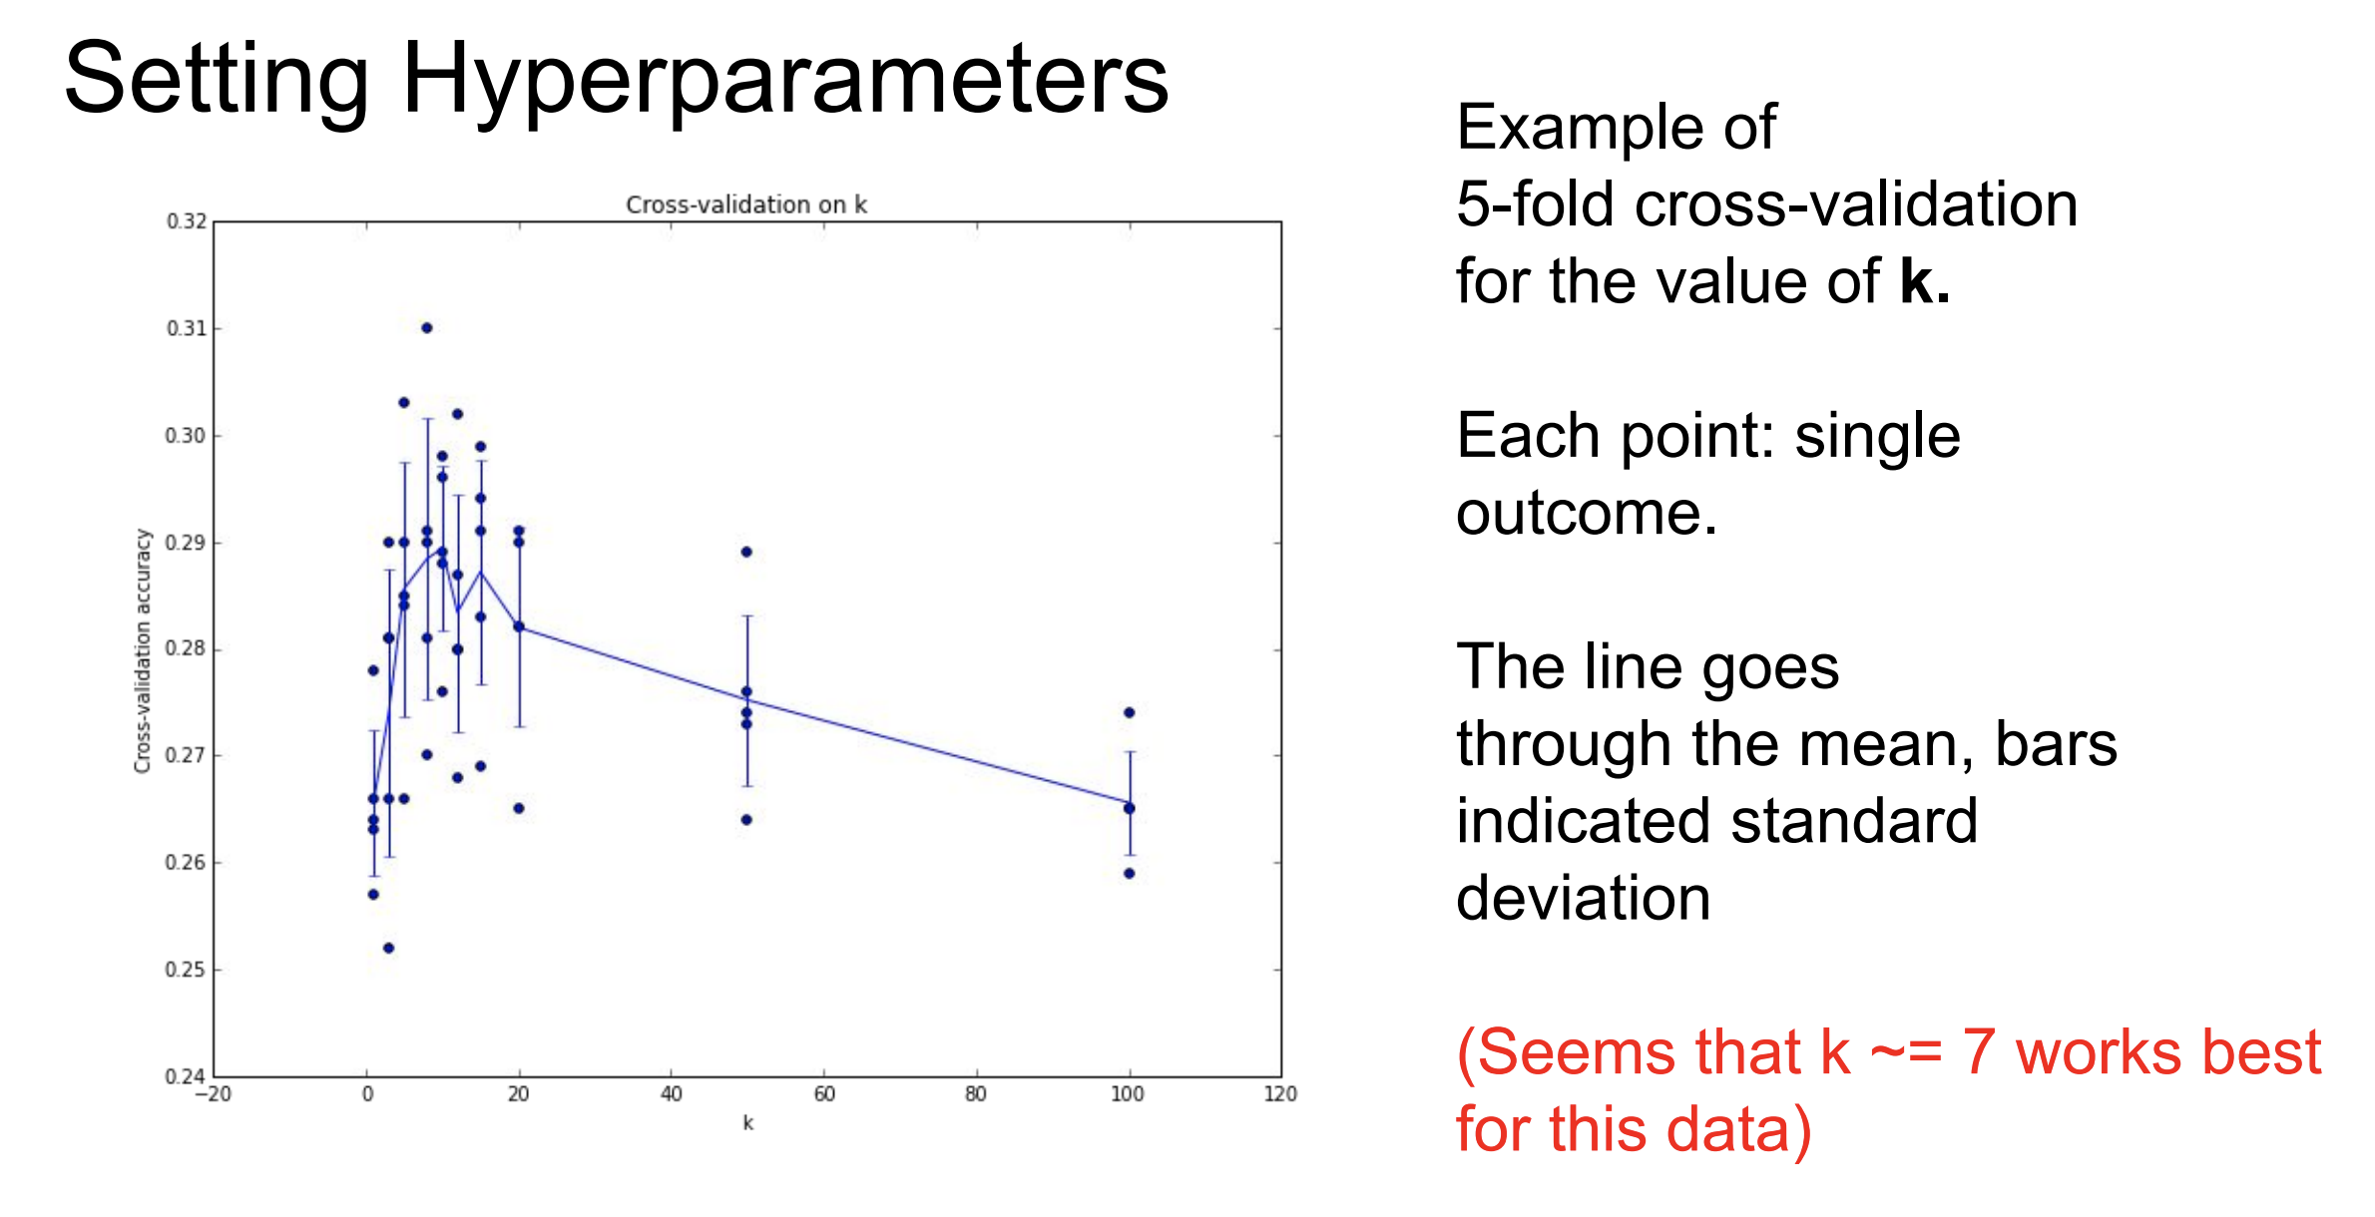
Classifier: K-Nearest Neighbor

Slide 44
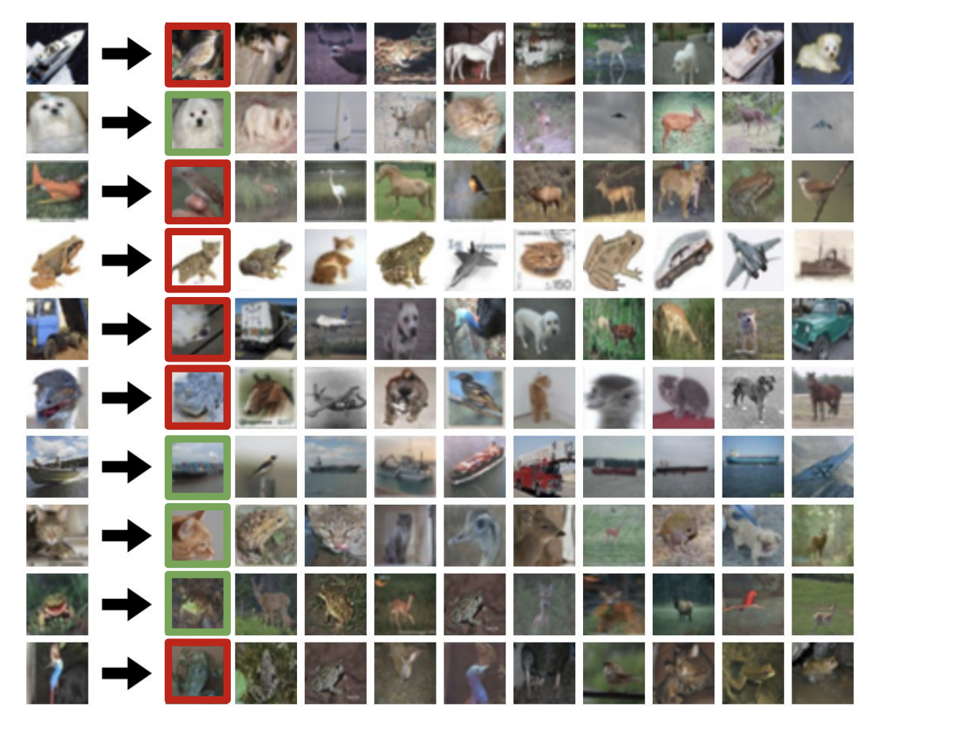
Classifier: K-Nearest Neighbor
Notes:
红色分类错误、绿色为分类正确

Slide 45
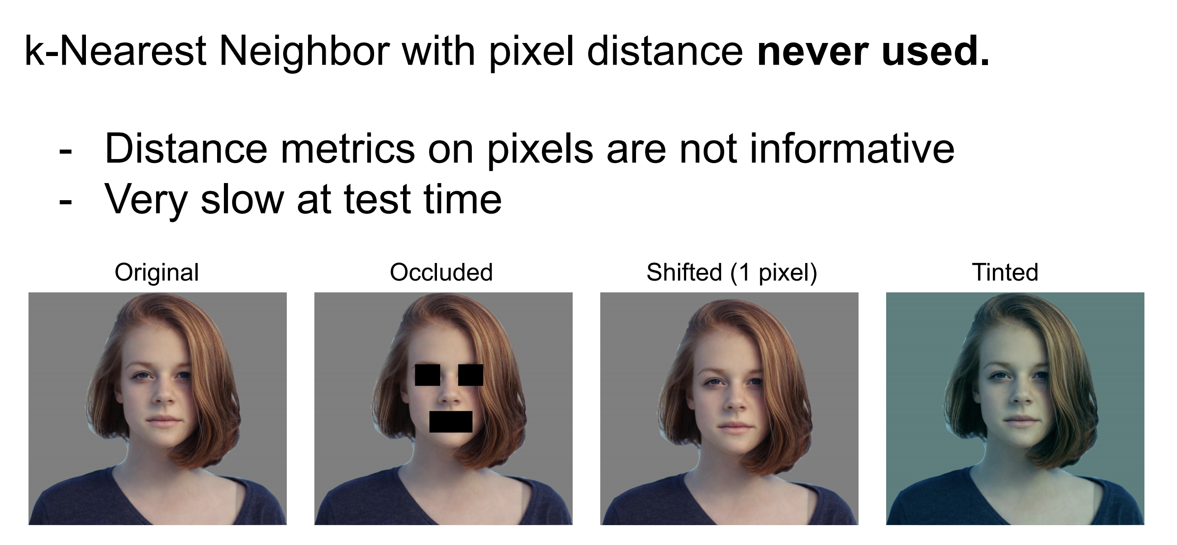
Classifier: K-Nearest Neighbor

Slide 46
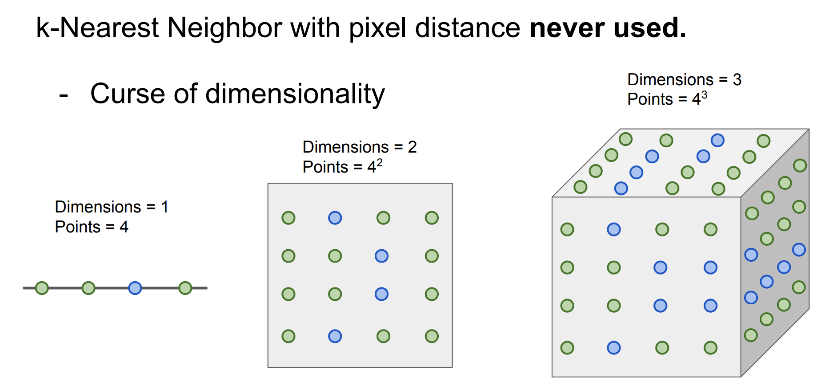
Classifier: K-Nearest Neighbor

Slide 47
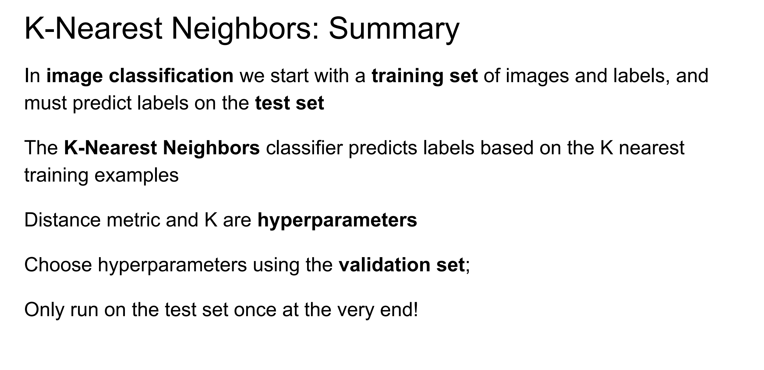
Classifier: K-Nearest Neighbor

Slide 48
Linear Classification

Slide 49
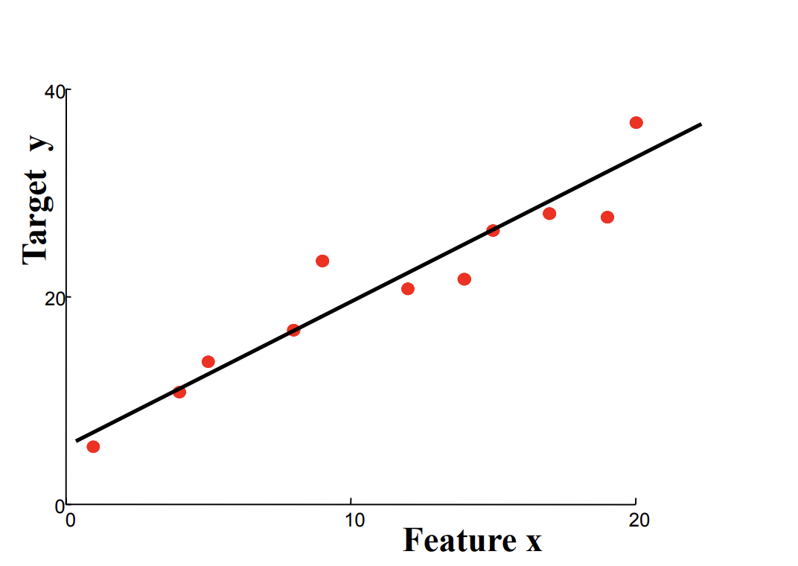
Classifier: Linear Classification
Linear Classification
A classification algorithm (Classifier) that makes its classification based on a linear predictor function combining a set of weights with the feature vector

Slide 50
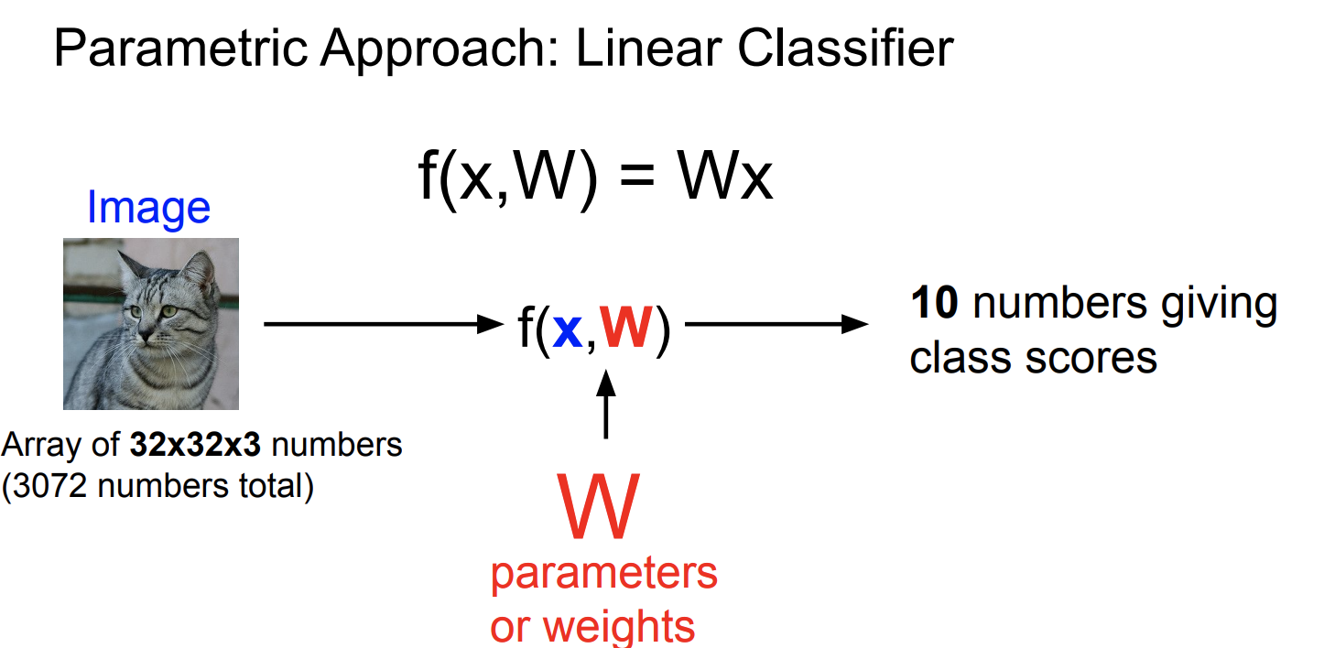
Classifier: Linear Classification

Slide 51
Classifier: Linear Classification

Slide 52
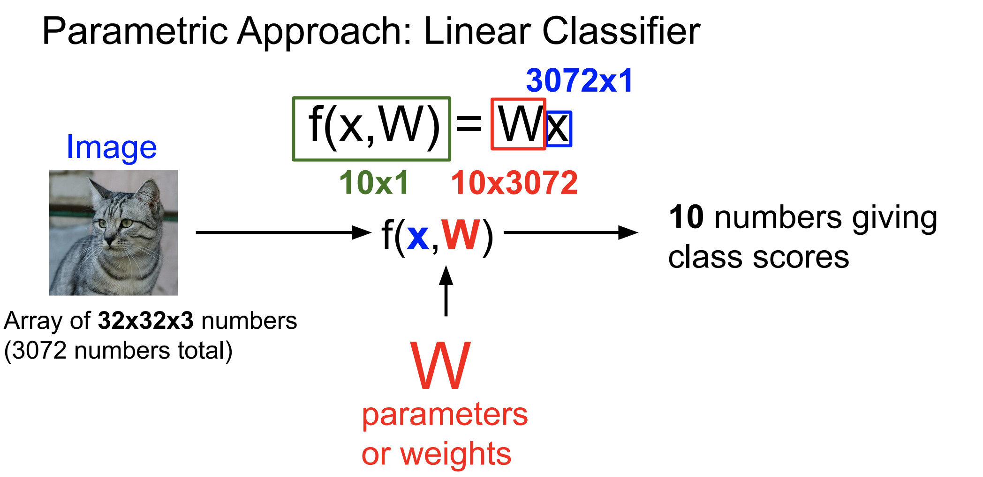
Classifier: Linear Classification

Slide 53
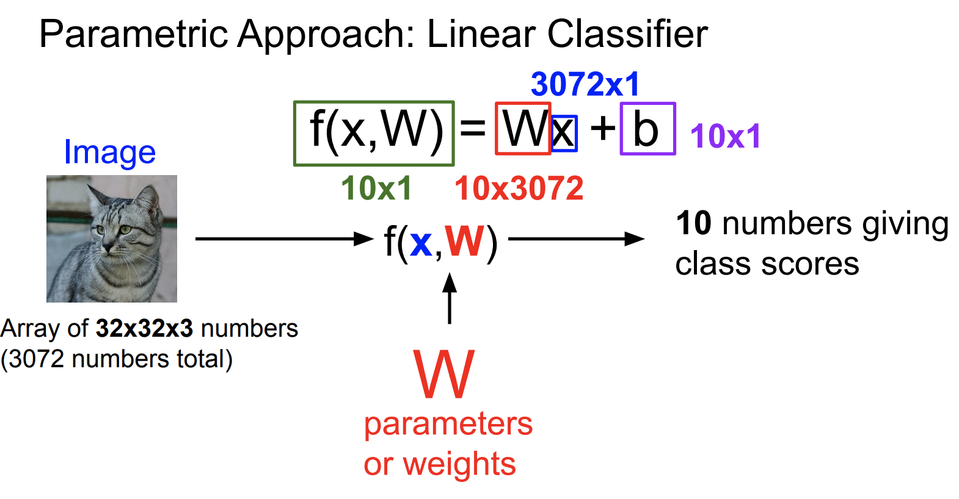
Classifier: Linear Classification

Slide 54
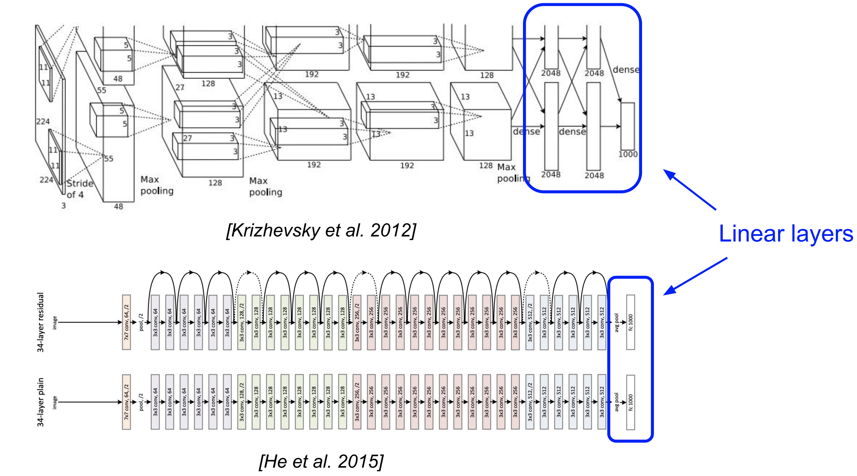
Classifier: Linear Classification
Linear layers in Neural Network

Slide 55
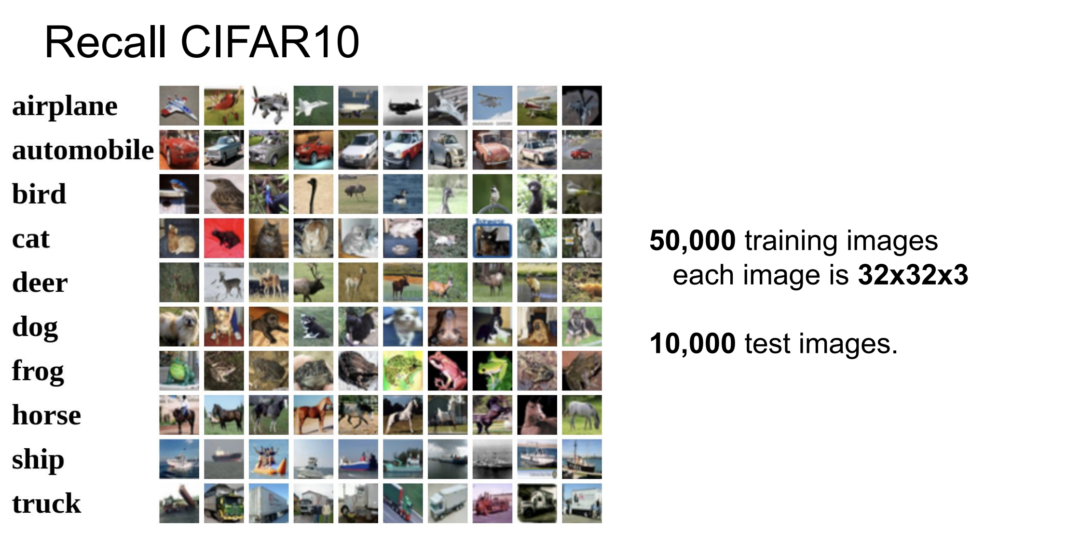
Classifier: Linear Classification

Slide 56
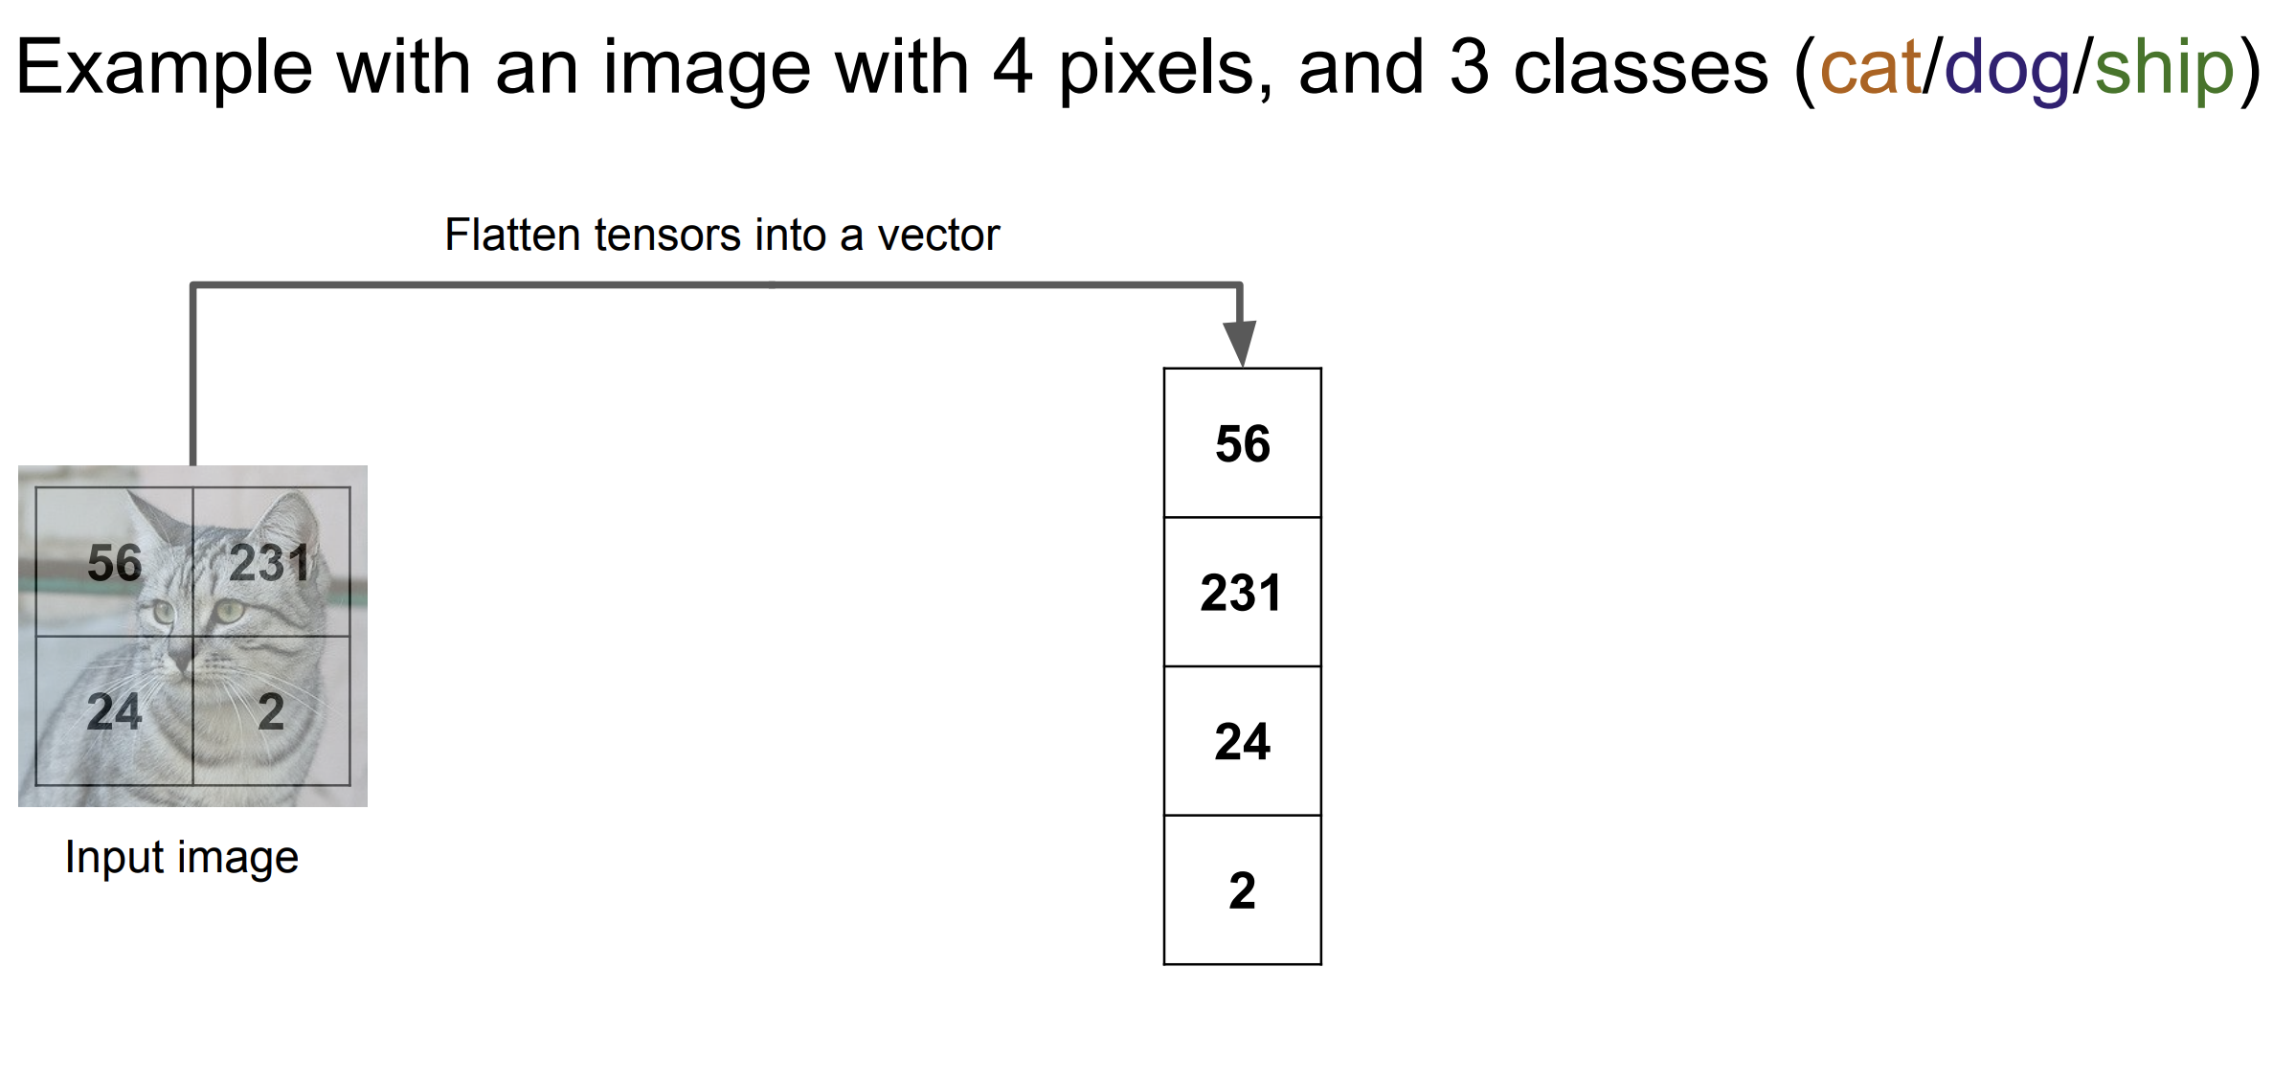
Classifier: Linear Classification

Slide 57
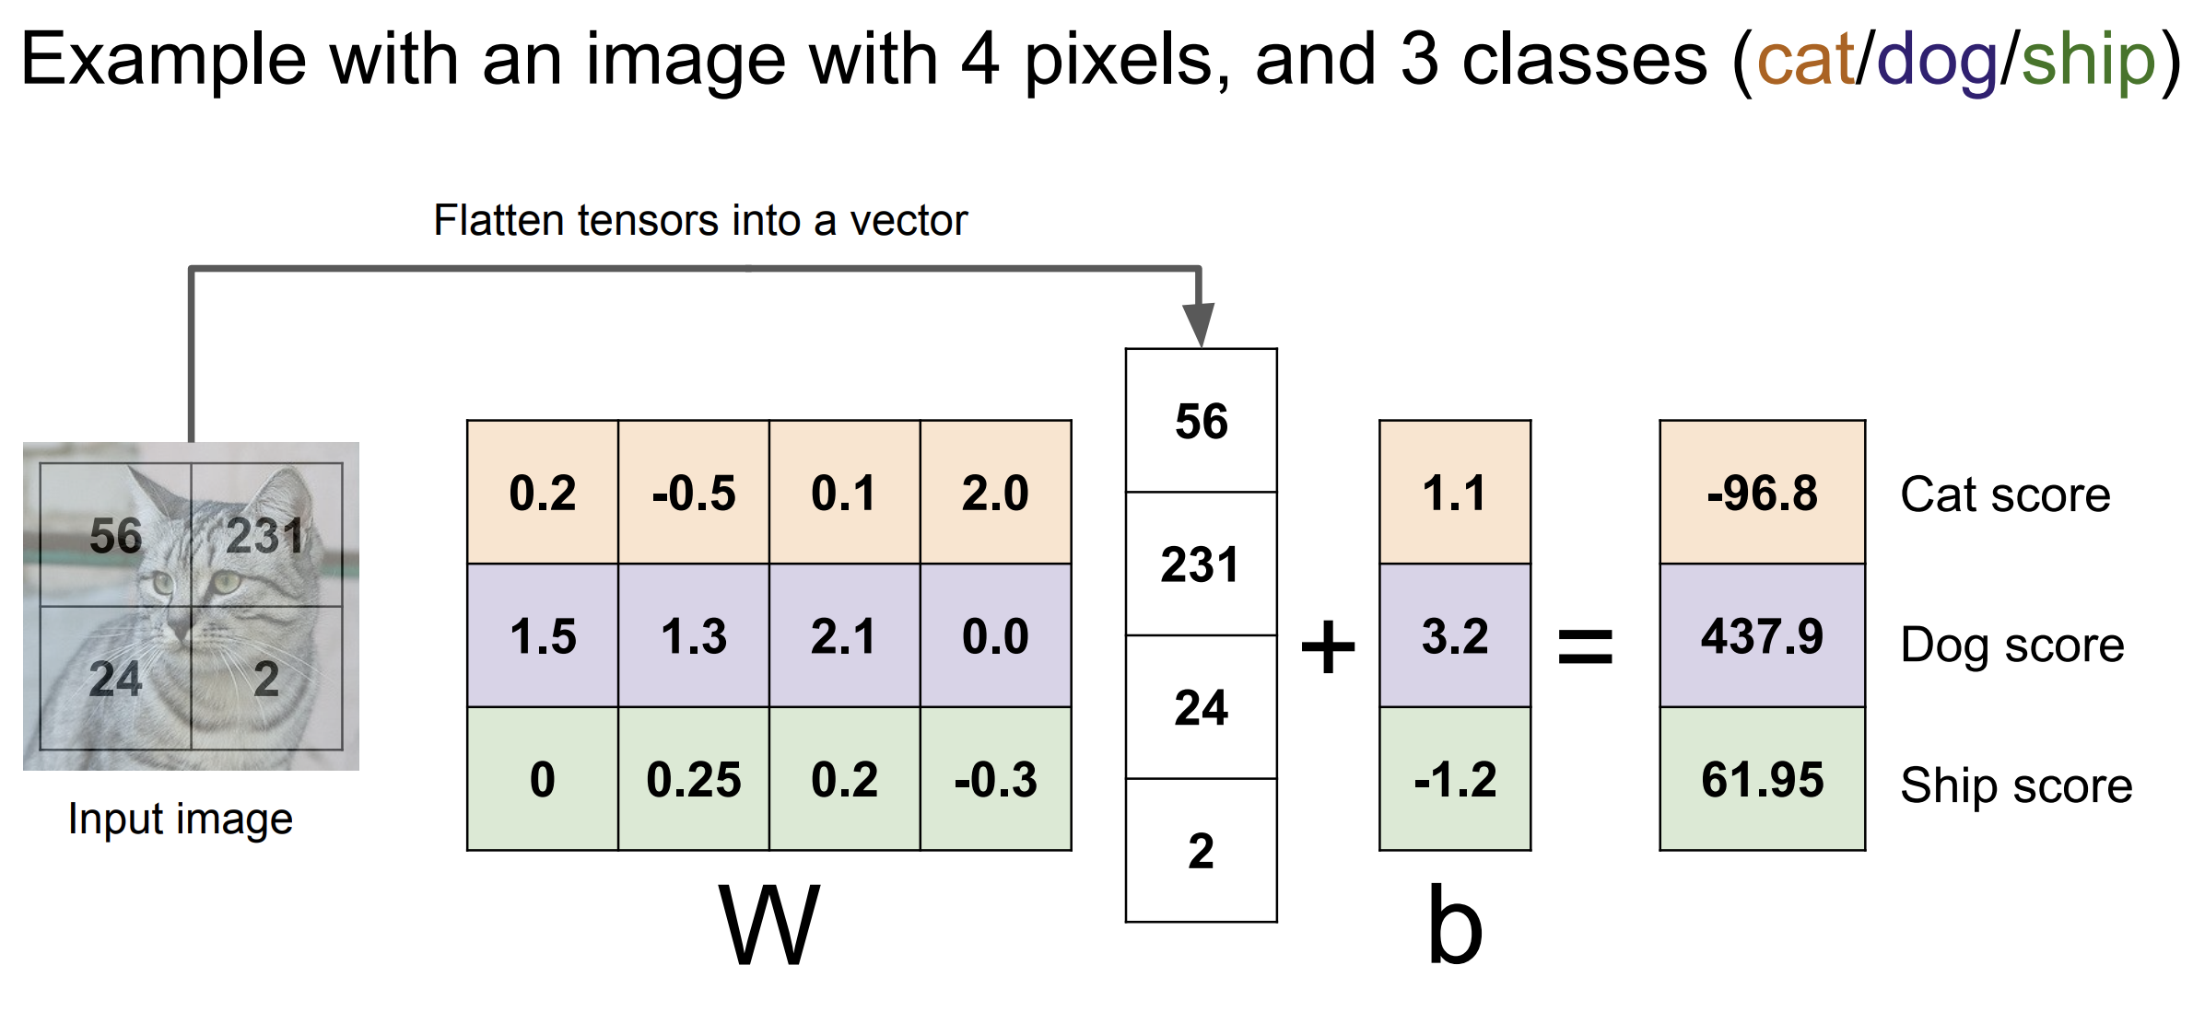
Classifier: Linear Classification

Slide 58
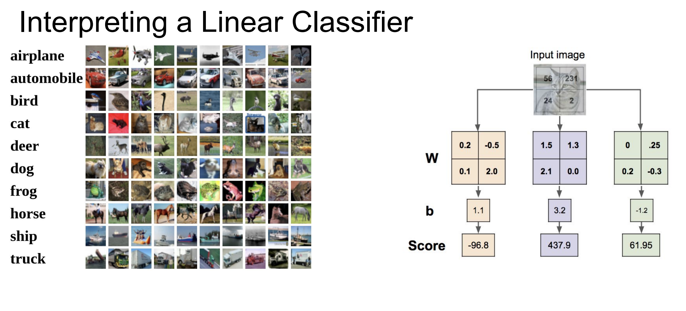
Classifier: Linear Classification

Slide 59
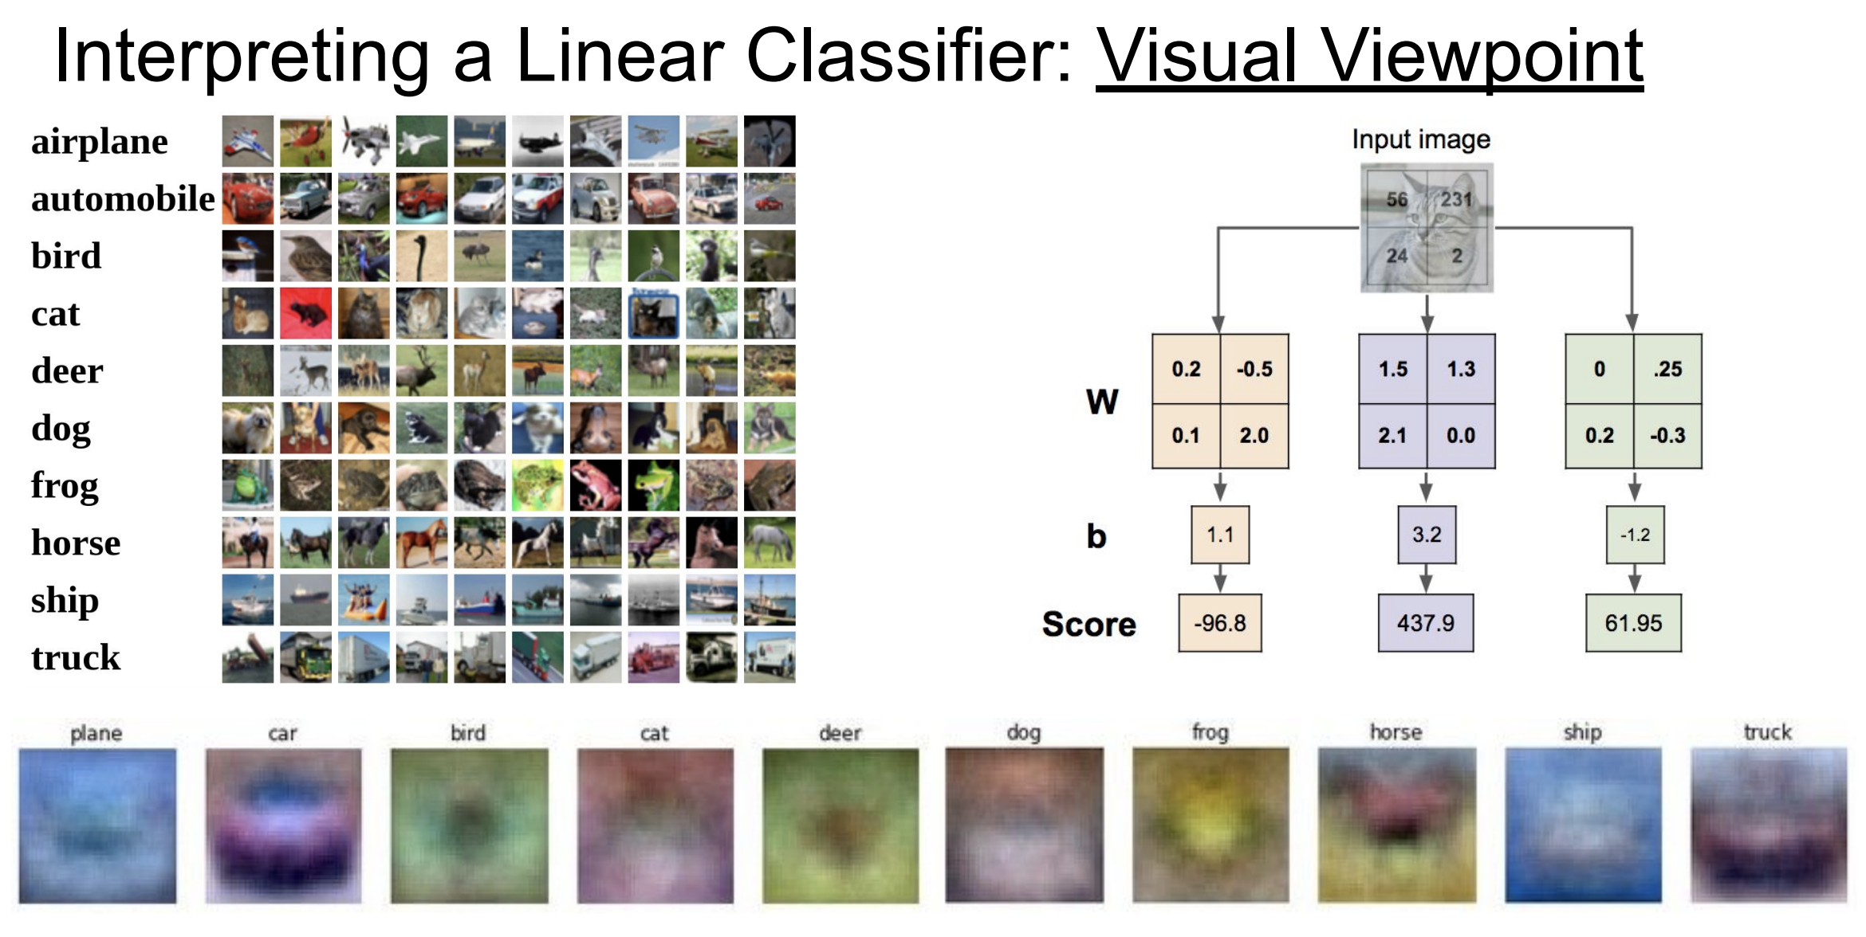
Classifier: Linear Classification

Slide 60
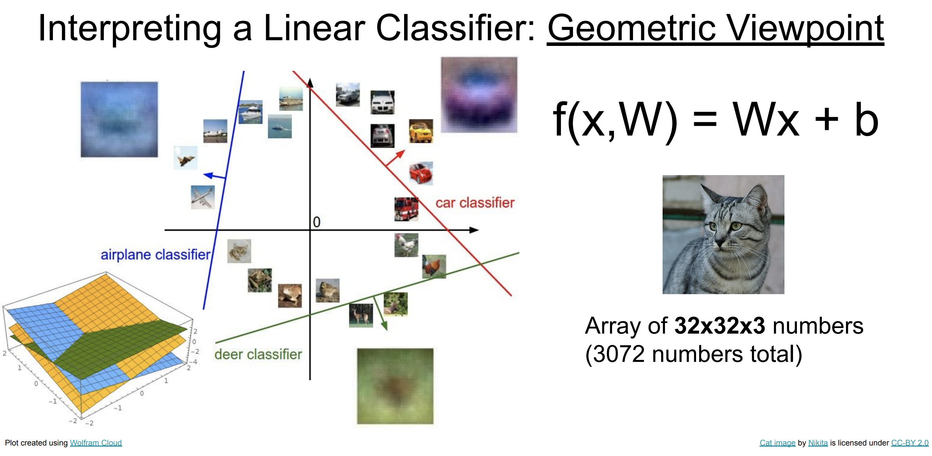
Classifier: Linear Classification

Slide 61
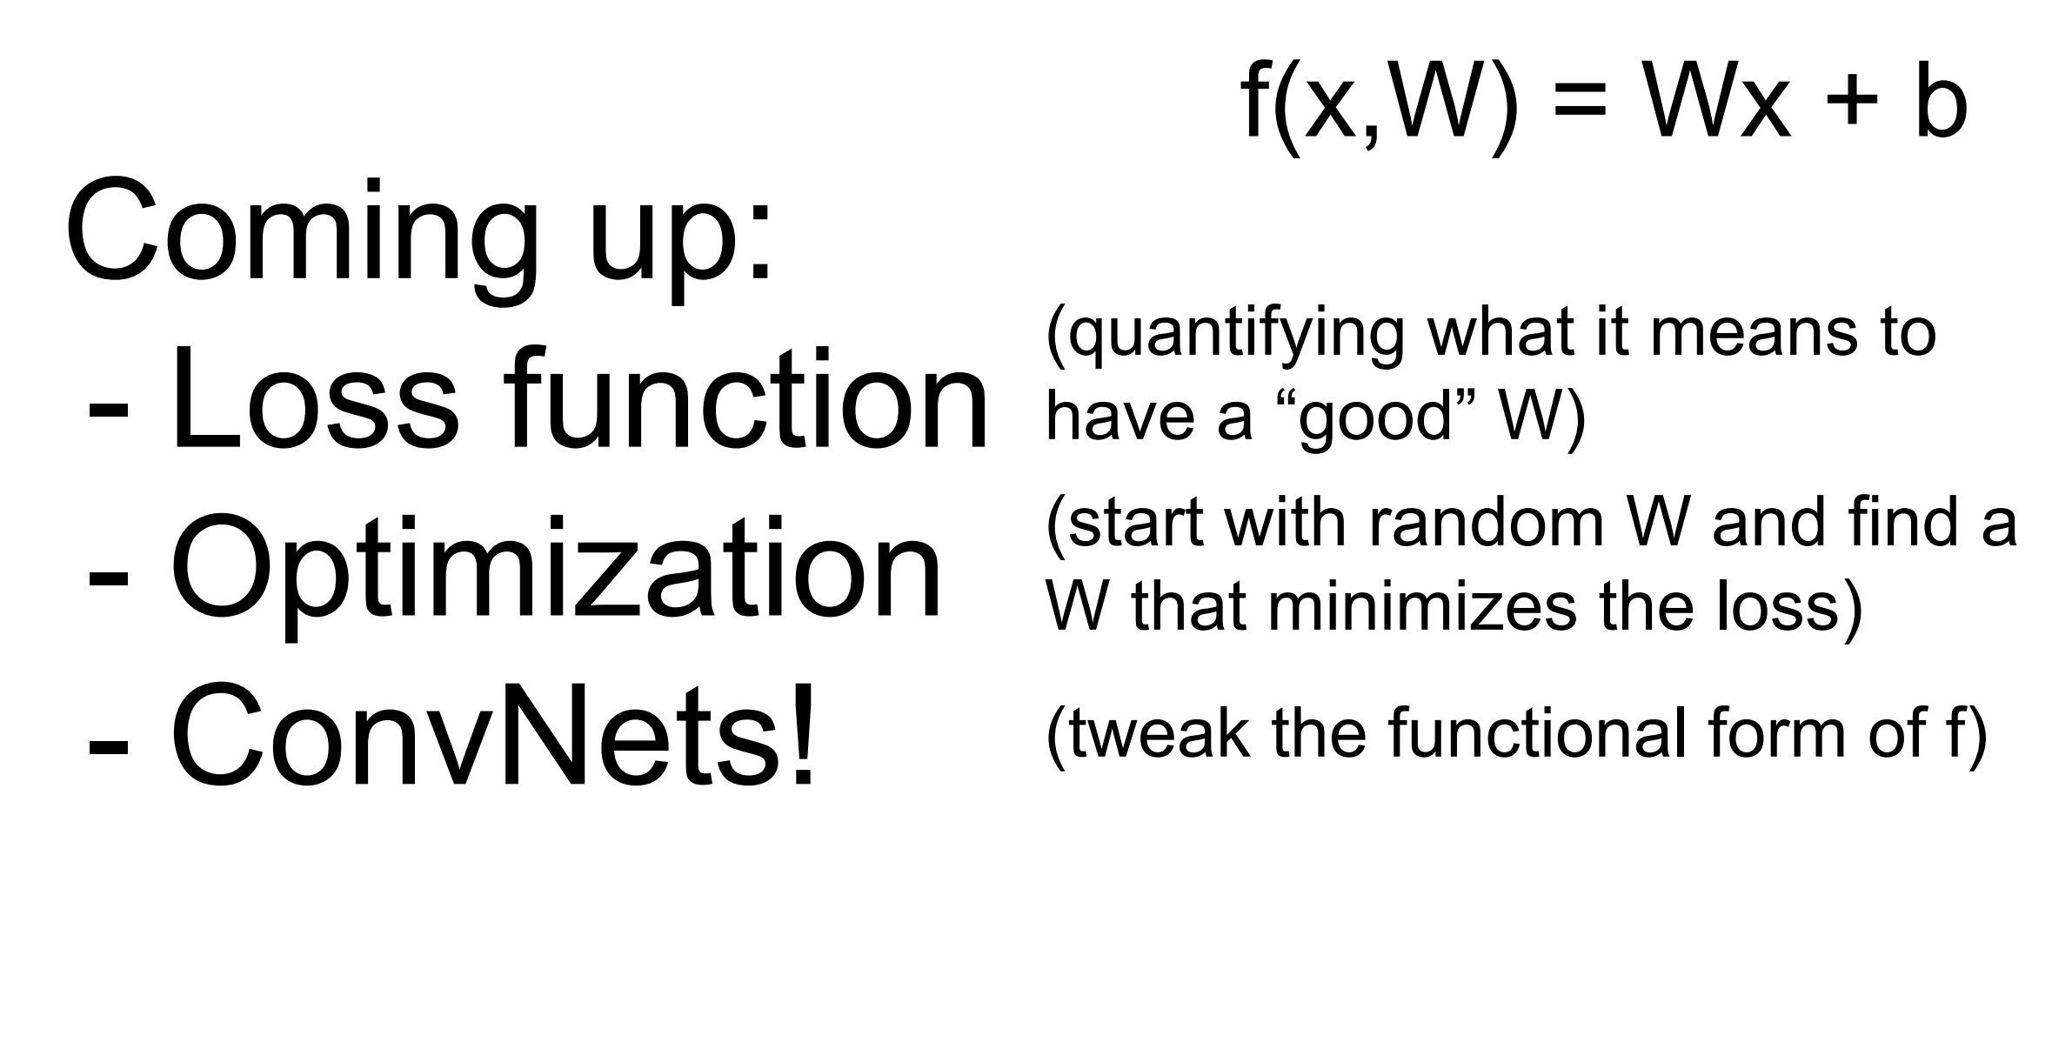
Classifier: Linear Classification

Slide 62

Classifier: Linear Classification
loss function

Slide 63

Classifier: Linear Classification
loss function

Slide 64

Classifier: Linear Classification
loss function

Slide 65

Classifier: Linear Classification
loss function

Slide 66

Classifier: Linear Classification
loss function

Slide 67

Classifier: Linear Classification
loss function

Slide 68

Classifier: Linear Classification
loss function

Slide 69

Classifier: Linear Classification
loss function

Slide 70

Classifier: Linear Classification
loss function

Slide 71

Classifier: Linear Classification
loss function

Slide 72

Classifier: Linear Classification

Slide 73

Classifier: Linear Classification

Slide 74

Classifier: Linear Classification

Slide 75

Classifier: Linear Classification
Regularization pushes against fitting the data too well so we don’t fit noise in the data

Slide 76

Classifier: Linear Classification

Slide 77

Classifier: Linear Classification

Slide 78
Classifier: Linear Classification
Express preferences over weights
Make the model simple so it works on test data
Improve optimization by adding curvature

Slide 79

Classifier: Linear Classification

Slide 80

Classifier: Linear Classification

Slide 81

Classifier: Linear Classification

Slide 82

Classifier: Linear Classification

Slide 83

Classifier: Linear Classification

Slide 84

Classifier: Linear Classification

Slide 85

Classifier: Linear Classification

Slide 86

Classifier: Linear Classification

Slide 87

Classifier: Linear Classification

Slide 88

Classifier: Linear Classification

Slide 89

Classifier: Linear Classification

Slide 90

Classifier: Linear Classification

Slide 91

Classifier: Linear Classification

Slide 92

Classifier: Linear Classification

Slide 93

Classifier: Linear Classification

Slide 94

Classifier: Linear Classification

Slide 95

Classifier: Linear Classification

Slide 96

Classifier: Linear Classification
How do we find the best W?

Slide 97

Classifier: Linear Classification
Optimization
How to compute W?

Slide 98

Classifier: Linear Classification
Optimization

Slide 99

Classifier: Linear Classification
Optimization

Slide 100

Classifier: Linear Classification
Optimization

Slide 101

Classifier: Linear Classification
Optimization

Slide 102

Classifier: Linear Classification
Optimization

Slide 103

Classifier: Linear Classification

Slide 104

Classifier: Linear Classification

Slide 105

Classifier: Linear Classification

